Slide 1
COSC 4370 Fall 2023 Interactive Computer Graphics M & W 5:30 to 7:00 PM
Prof. Victoria Hilford
PLEASE TURN your webcam ON
NO CHATTING during LECTURE

Slide 2
COSC 4370
5:30 to 7
PLEASE
LOG IN
CANVAS
Please close all other windows.

Slide 3
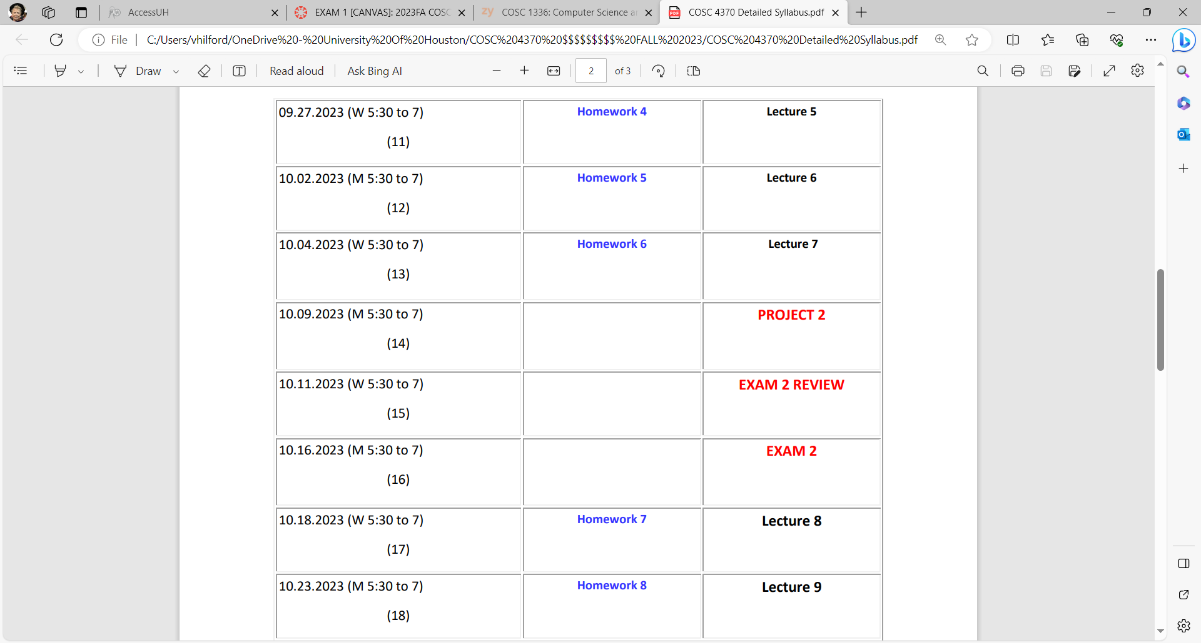
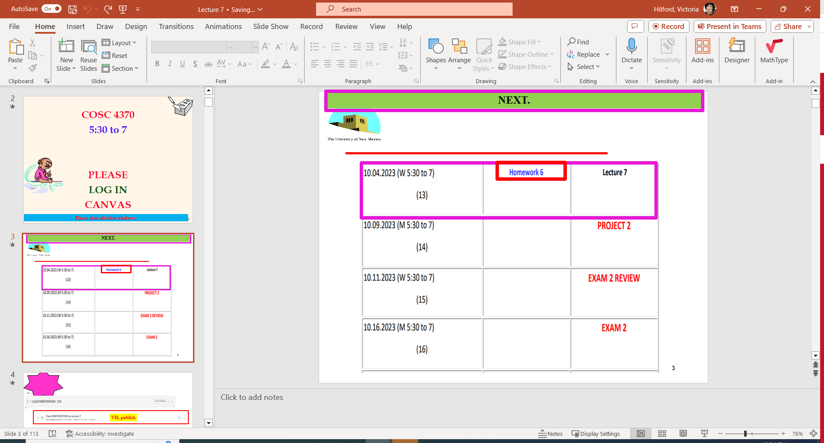
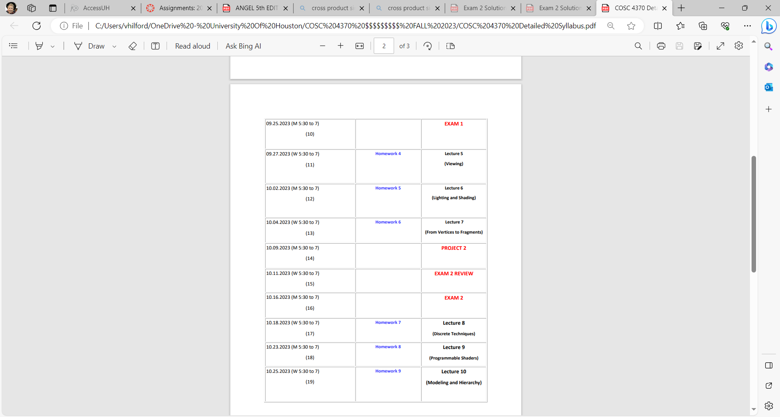
NEXT.

Slide 4
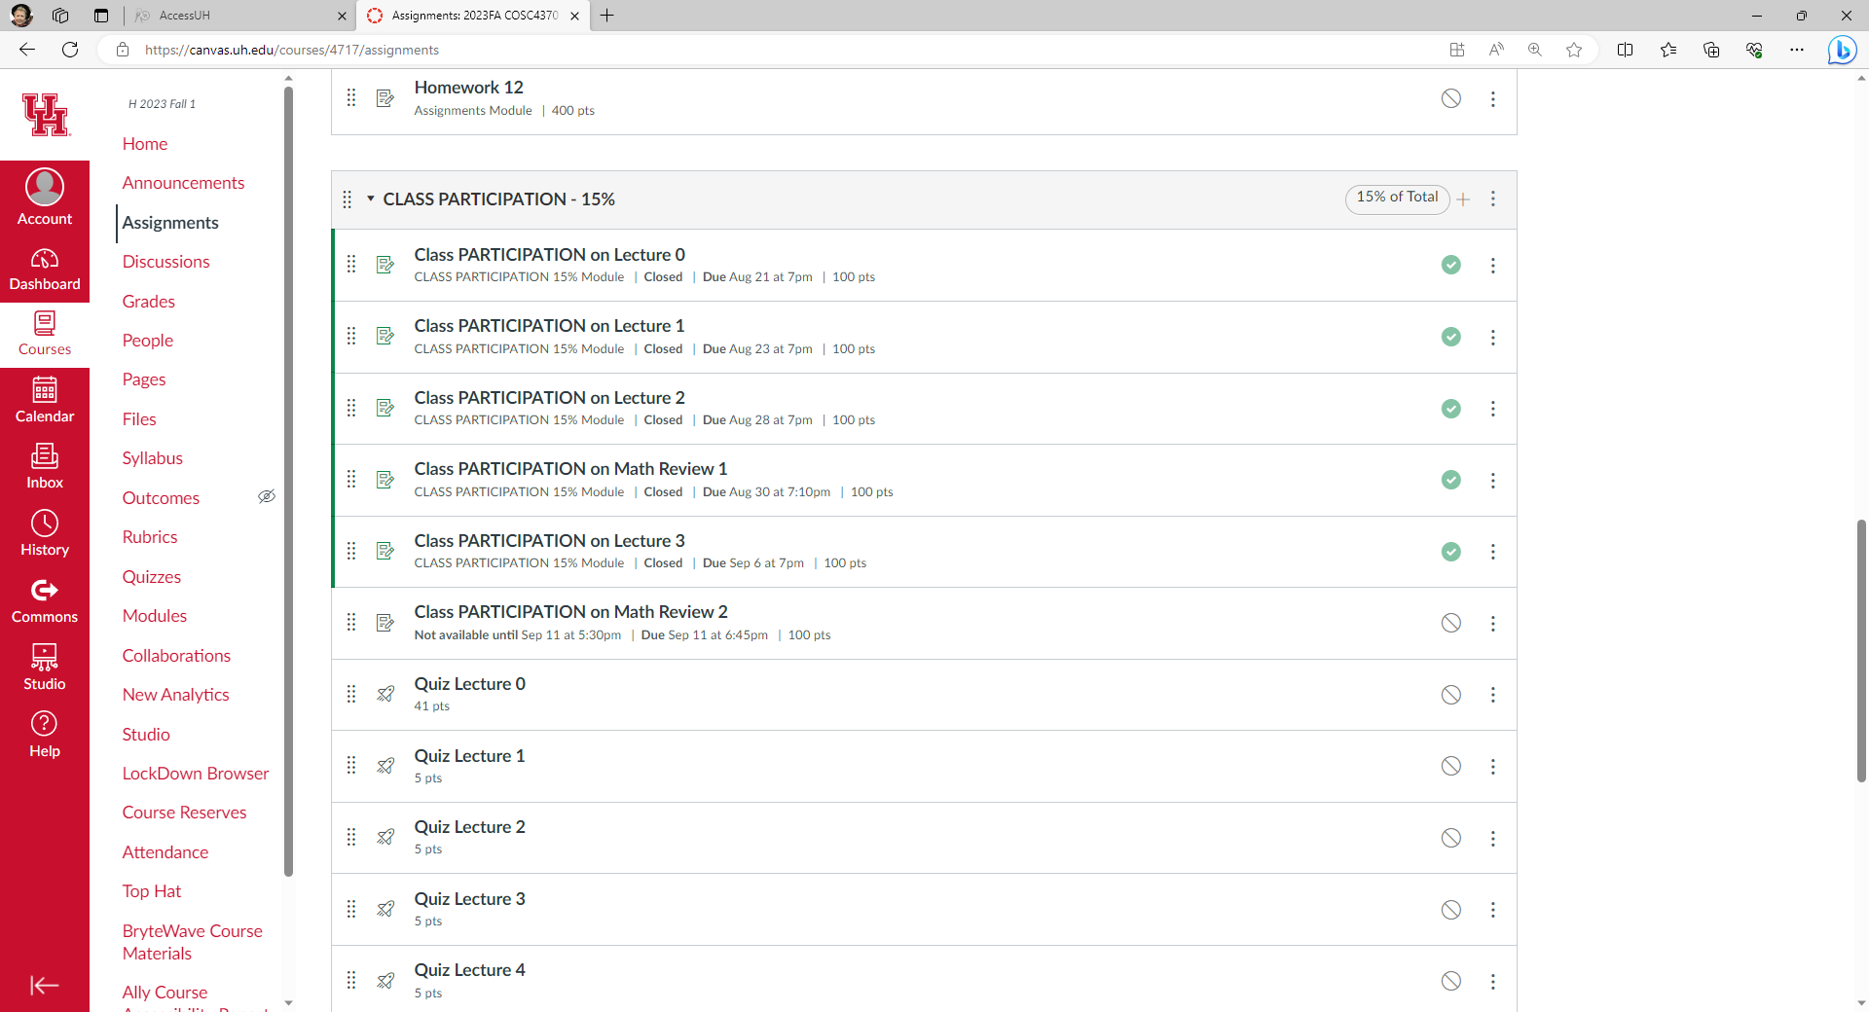

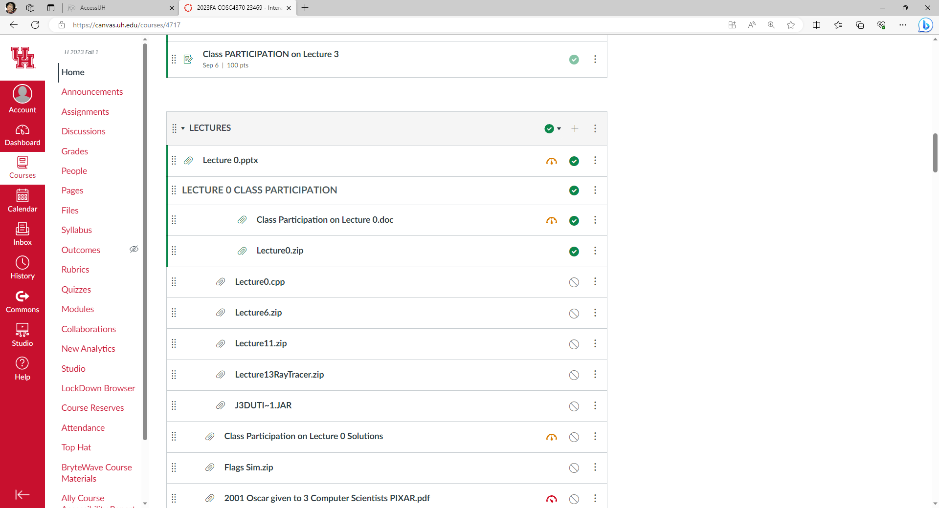

VH, publish
VH, publish

Slide 5


Slide 6
Lecture 7 From Vertices to Fragments Chapter 7
COSC 4370 – Computer Graphics

Slide 7
SUMMARY and NOTES
We have presented an overview of the implementation process, including a sampling of the most important algorithms. Regardless of what the particulars of an implementation are whether the tasks are done primarily in hardware or in software, whether we are working with a special- purpose graphics workstation or with a simple graphics terminal, and what the API is the same tasks must be done. These tasks include implementation of geometric transformations, clipping, and rasterization. The relationship among hardware, software, and APIs is an interesting one.
The Geometry Engine that was the basis of many Silicon Graphics workstations is a VLSI chip that performed geometric transformations and clipping through a hardware pipeline. GL, the predecessor of OpenGL, was developed as an API for users of these workstations. Much of the OpenGL literature also follows the pipeline approach. We should keep in mind, however, that OpenGL is an API: It does not say much about the underlying implementation. In principle, an image defined by an OpenGL program could be obtained from a ray tracer. We should carry away two lessons from our emphasis on pipeline architectures. First, this architecture provides an aid to the applications programmer in understanding the process of creating images. Second, at present, the pipeline view can lead to efficient hardware and software implementations.
The example of the z- buffer algorithm is illustrative of the relationship between hardware and software. Fifteen years ago, many hidden-surface removal algorithms were used, of which the z- buffer algorithm was only one. The availability of fast dense inexpensive memory has made the z- buffer algorithm the dominant method for hidden- surface removal.
A related example is that of workstation architectures, where special- purpose graphics chips have made remarkable advances in just the past few years. Not only has graphics performance increased at a rate that exceeds Moores law, but many new features have become available in the graphics processors. As we will see in Chapter 9, the new programmable architectures open up many new possibilities.
Notes:
SUMMARY AND NOTES We have presented an overview of the implementation process, including a sampling of the most important algorithms. Regardless of what the particulars of an implemen-tation are whether the tasks are done primarily in hardware or in software, whether we are working with a special- purpose graphics workstation or with a simple graph-ics terminal, and what the API is the same tasks must be done. These tasks include implementation of geometric transformations, clipping, and rasterization. The rela-tionship among hardware, software, and APIs is an interesting one. The Geometry Engine that was the basis of many Silicon Graphics workstations is a VLSI chip that performed geometric transformations and clipping through a hardware pipeline. GL, the predecessor of OpenGL, was developed as an API for users of these workstations. Much of the OpenGL literature also follows the pipeline approach. We should keep in mind, however, that OpenGL is an API: It does not say much about the underlying implementation. In principle, an image defined by an OpenGL program could be obtained from a ray tracer. We should carry away two lessons from our emphasis on pipeline architectures. First, this architecture provides an aid to the applications programmer in understanding the process of creating images. Second, at present, the pipeline view can lead to efficient hardware and software implementations. The example of the z- buffer algorithm is illustrative of the relationship between hardware and software. Fifteen years ago, many hidden- surface removal algorithms were used, of which the z- buffer algorithm was only one. The availability of fast dense inexpensive memory has made the z- buffer algorithm the dominant method for hidden- surface removal.
A related example is that of workstation architectures, where special- purpose graphics chips have made remarkable advances in just the past few years. Not only has graphics performance increased at a rate that exceedsMoores law, but many new features have become available in the graphics processors. As we will see in Chapter 9, the new programmable architectures open up many new possibilities. So what does the future hold? Certainly, graphics systems will get faster and cheaper. More than any other factor, advances in hardware probably will dictate what future graphics systems will look like. Presently, hardware development is being driven by the game industry. For less than $ 200, we can purchase a graphics card that exceeds the performance of graphics workstations that a few years ago would have cost more than $ 100,000. The features and performance of these cards are optimized for the needs of the computer game industry. Thus, we do not see uniform speedups in the various graphics functions that we have presented. In addition, new hardware features are appearing far faster than they can be incorporated into standard APIs. However, the speeds at which these processors operate have challenged both the graphics and scientific communities to discover new algorithms to solve problems that until now had always been solved using conventional architectures. On the software side, the low cost and speed of recent hardware has enabled soft-ware developers to produce rendering software that allows users to balance rendering time and quality of rendering. Hence, a user can add some ray- traced objects to a scene, the number depending on how long she is willing to wait for the rendering. The future of standard APIs is much less clear. On one hand, users in the scientific community prefer stable APIs, such as OpenGL, so that application code will have a long lifetime. On the other hand, users want to exploit new hardware features that are not supported on all systems. Numerous advanced architectures under exploration use massive parallelism. How parallelism can be exploited most effectively for computer graphics is still an open issue. Our two approaches to rendering object- oriented and image oriented lead to two entirely different ways to develop a parallel renderer, which we will explore further in Chapter 13. We have barely scratched the surface of implementation. The literature is rich with algorithms for every aspect of the implementation process. The references should help you to explore this topic further.

Slide 8
Rendering Pipeline
The Graphics Pipeline
Front End
per vertex
Geometry Pipeline
Geometry
Database
Model/View
Transform.
Lighting
Perspective
Transform.
Clipping
Frame-
buffer
Scan
Conversion
Texturing
Depth
Test
Blending
Back End
per fragment

Slide 9
Projective Rendering Pipeline
glVertex3f(x,y,z)
viewing/camera
object
world
WCS
VCS
alter w
OCS
glFrustum(...)
modeling
transformation
viewing
transformation
projection
transformation
glTranslatef(x,y,z)
glRotatef(th,x,y,z)
....
gluLookAt(...)
clipping
/ w
perspective
division
OCS - object coordinate system
WCS - world coordinate system
VCS - viewing coordinate system
CCS - clipping coordinate system
NDCS - normalized device coordinate system
DCS - device coordinate system
normalized
device
NDCS
glutInitWindowSize(w,h)
glViewport(x,y,a,b)
viewport
transformation
device
DCS

Slide 10
Projective Transformations
transformation of space
center of projection (COP) moves to infinity
viewing frustum transformed into a parallelepiped
x
x
Frustum
-z
-z

Slide 11
Normalized Device Coordinates
left/right x =+/- 1, top/bottom y =+/- 1, near/far z =+/- 1
Camera coordinates
NDC
x
x
x=1
right
Frustum
-z
z
left
x= -1
z= -1
z=1
z=-n
z=-f

Slide 12
Projection Normalization
distort such that orthographic projection of distorted objects is desired perspective projection
x
x
-z
z

Slide 13
Transforming View Volumes
perspective view volume
orthographic view volume
y=top
y=top
x=left
x=left
y
y
z
x=right
VCS
VCS
y=bottom
z=-near
z=-far
x
z=-far
x
y=bottom
x=right
z=-near
NDCS
y
(1,1,1)
z
(-1,-1,-1)
x

Slide 14
Basic Perspective Projection
y
P(x,y,z)
similar triangles
P(x’,y’,d)
but
z
z=d
=
also
=
non-uniform foreshortening
not affine

Slide 15
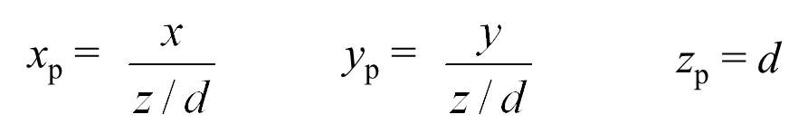
Basic Perspective Projection
can express as homogenous 4x4 matrix!
P(x’,y’,d)
P(x,y,z)

Slide 16
Projective Transformations
determining the matrix representation
need to observe 5 points in general position, e.g.
[left,0,0,1]^{T}→[-1,0,0,1]^{T}
[0,top,0,1]^{T}→[0,1,0,1]^{T}
[0,0,-f,1]^{T}→[0,0,1,1]^{T}
[0,0,-n,1]^{T}→[0,0,-1,1]^{T}
[left*f/n,top*f/n,-f,1]^{T}→[-1,1,1,1]^{T}
solve resulting equation system to obtain matrix

Slide 17
Transforming View Volumes
perspective view volume
orthographic view volume
y=top
y=top
x=left
x=left
y
y
z
x=right
VCS
VCS
y=bottom
z=-near
z=-far
x
z=-far
x
y=bottom
x=right
z=-near
NDCS
y
(1,1,1)
z
(-1,-1,-1)
x

Slide 18
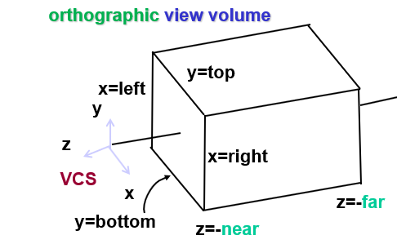
OpenGL Orthographic Matrix
scale, translate for new coordinate system
understand derivation!
x
x
y
y
z
z

Slide 19
Transforming View Volumes
perspective view volume
orthographic view volume
y=top
y=top
x=left
x=left
y
y
z
x=right
VCS
VCS
y=bottom
z=-near
z=-far
x
z=-far
x
y=bottom
x=right
z=-near
NDCS
y
(1,1,1)
z
(-1,-1,-1)
x

Slide 20
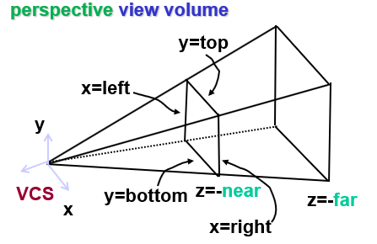
OpenGL Perspective Matrix
shear, scale, reflect for new coordinate system
understand derivation!
x
x
y
y
z
z

Slide 21
Viewport Transformation
onscreen pixels: map from [-1,1] to [0, display width]
y
x
(1,1)
display
NDCS
y
x
DCS
viewport
(-1,-1)
(w,h)
(0,0)
x
y
DCS
b
DCS
b
a
a
(0,0)
x
y
(w,h)

Slide 22
The Rendering Pipeline
Geometry
Database
Model/View
Transform.
Lighting
Perspective
Transform.
Clipping
vertex
fragment
Frame-
buffer
Scan
Conversion
Texturing
Depth
Test
Blending
Back End
per pixel (fragment)

Slide 23
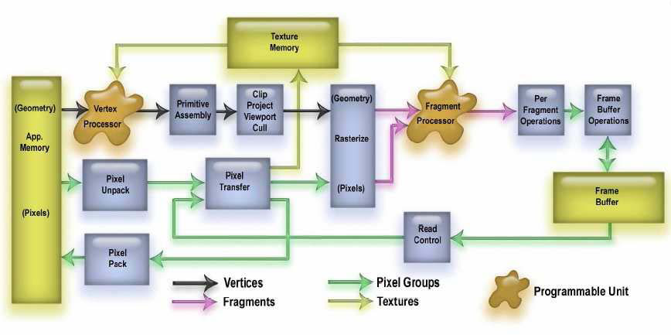
OpenGL Graphics Pipeline
Frame
Buffer

Slide 24
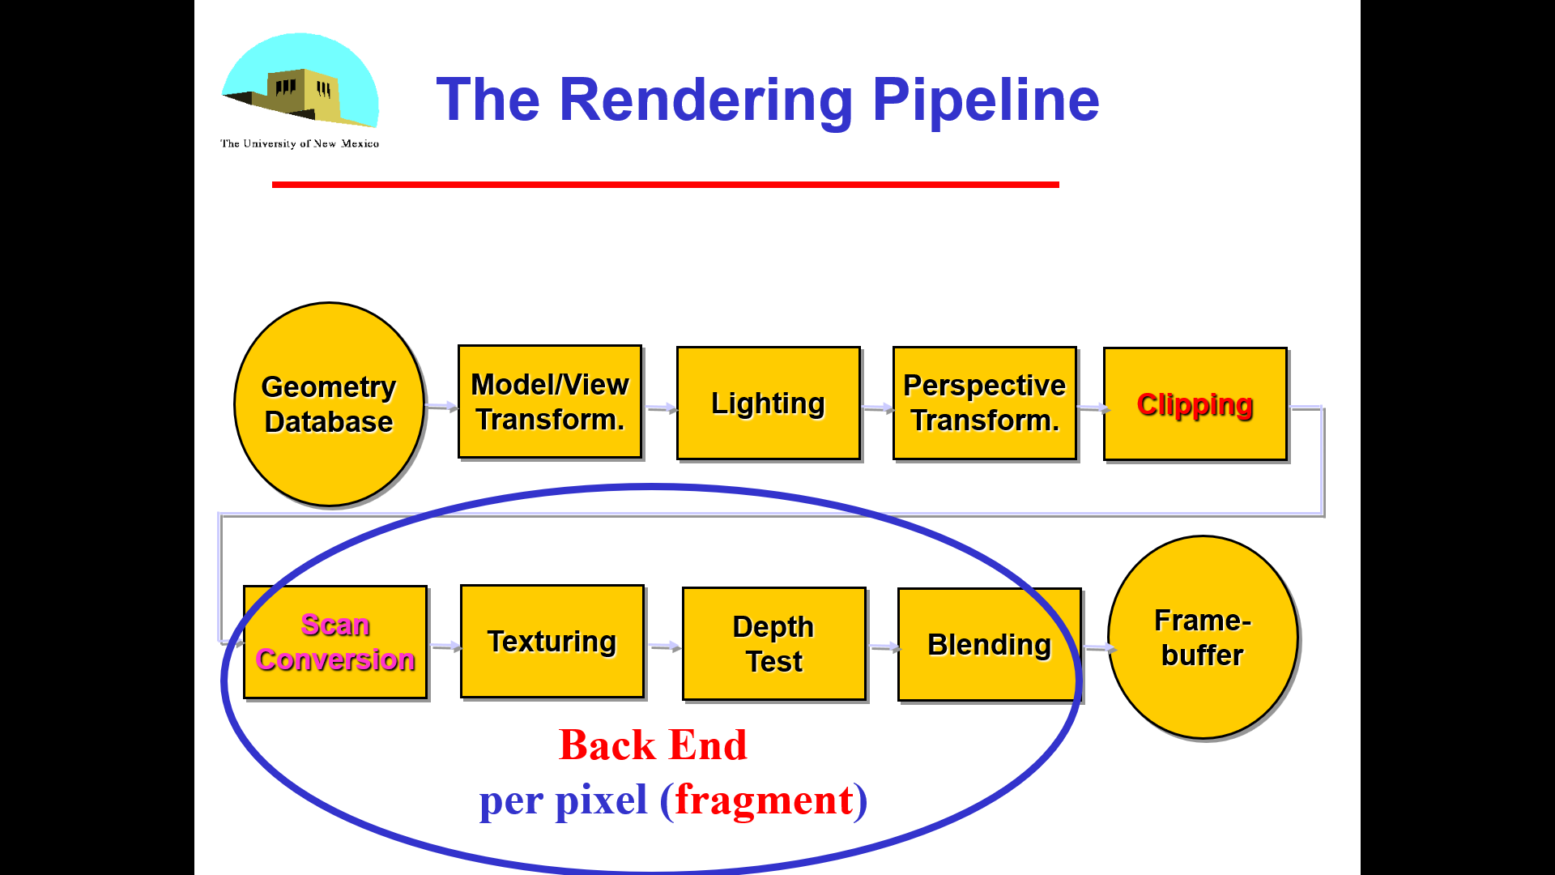
Pipeline Implementation
We need only to transform the homogeneous-coordinate representation of the endpoints of a line segment to determine completely a transformed line. Thus, we can implement our graphics systems as a pipeline that passes endpoints through affine transformation units and generates the interior points at the rasterization stage.
T
(from application program)
frame
buffer
u
transformation
T(u)
Rasterizer
(Scan Conversion)
v
T(v)
T(v)
v
T(v)
T(u)
u
T(u)
vertices
vertices
pixels
24
Notes:
We need only to transform the homogeneous-coordinate representation of the endpoints of a line segment to determine completely a transformed line.
Thus, we can implement our graphics systems as a pipeline that passes endpoints through affine transformation units and generates the interior points at the rasterization stage.

Slide 25
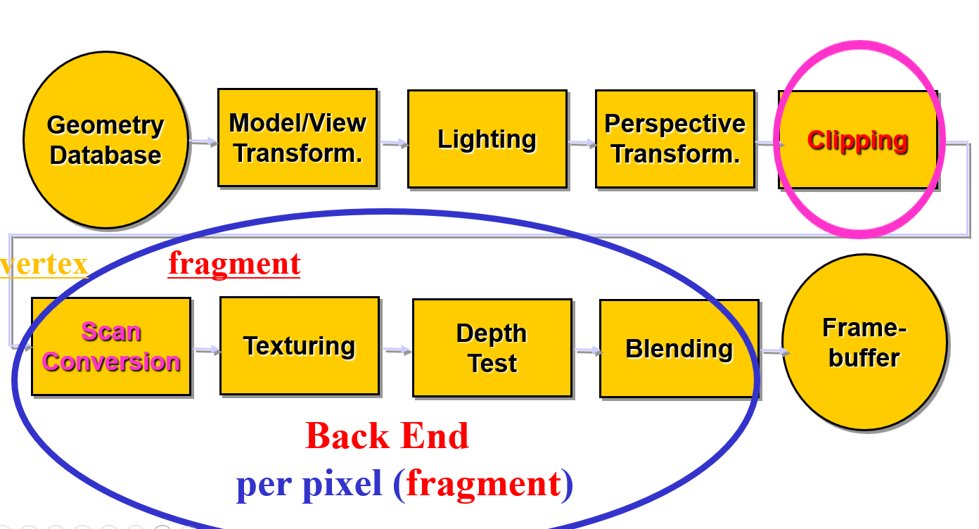
Implementation I
We now turn to the next steps in the pipeline: clipping, rasterization, and hidden- surface removal.
First, you may be wondering how your programs are processed by the system that you are using: how lines are drawn on the screen, how polygons are filled, and what happens to primitives that lie outside the viewing volumes defined in your program.
Second, our contention is that if we are to use a graphics system efficiently, we need to have a deeper understanding of the implementation process: which steps are easy, and which ones tax our hardware and software.
Third, our discussion of implementation will open the door to new capabilities that are supported by the latest hardware. Learning implementation involves studying algorithms. As when we study other algorithms, we must be careful to consider such issues as theoretical versus practical performance, hardware versus software implementations, and the specific characteristics of an application. Although we can test whether an OpenGL implementation works correctly, in the sense that it produces the correct pixels on the screen, there are many choices for the algorithms employed. We focus on the basic operations that are necessary to implement a standard API and are required, whether the rendering is done by a pipeline architecture or by some other method, such as a ray tracer.
25
Notes:
W e now turn to the next steps in the pipeline: clipping, rasterization, and hidden- surface removal. Although we have yet to consider some major parts of OpenGL that are available to the application programmer, including discrete primitives, texture mapping, and curves and surfaces, there are several reasons for considering these topics at this point. First, you may be wondering how your pro-grams are processed by the system that you are using: how lines are drawn on the screen, how polygons are filled, and what happens to primitives that lie outside the viewing volumes defined in your program. Second, our contention is that if we are to use a graphics system efficiently, we need to have a deeper understanding of the implementation process: which steps are easy, and which ones tax our hardware and software. Third, our discussion of implementation will open the door to new capa-bilities that are supported by the latest hardware. Learning implementation involves studying algorithms. As when we study other algorithms, we must be careful to consider such issues as theoretical versus practical performance, hardware versus software implementations, and the specific character-istics of an application. Although we can test whether an OpenGL implementation works correctly, in the sense that it produces the correct pixels on the screen, there are many choices for the algorithms employed. We focus on the basic operations that are necessary to implement a standard API and are required, whether the rendering is done by a pipeline architecture or by some other method, such as a ray tracer. Con-sequently, we present a variety of the basic algorithms for each of the principal tasks in an implementation. In this chapter, we are concerned with the basic algorithms that are used to implement the rendering pipeline used by OpenGL. We will focus on three issues: clipping, rasterization, and hidden- surface removal. Clipping involves eliminating objects that lie outside the viewing volume and thus cannot be visible in the image. Rasterization produces fragments from the remaining objects. These fragments can contribute to the final image. Hidden- surface removal determines which fragments correspond to objects that are visible, namely those that are in the view volume and are not blocked from view by other objects closer to the camera.

Slide 26
Implementation I
NDCS
y
(1,1,1)
z
(-1,-1,-1)
x
26

Slide 27
Objectives
Introduce basic implementation strategies
Clipping
Scan conversion
27

Slide 28
Objectives
Introduce basic implementation strategies
Clipping
Scan conversion
28

Slide 29
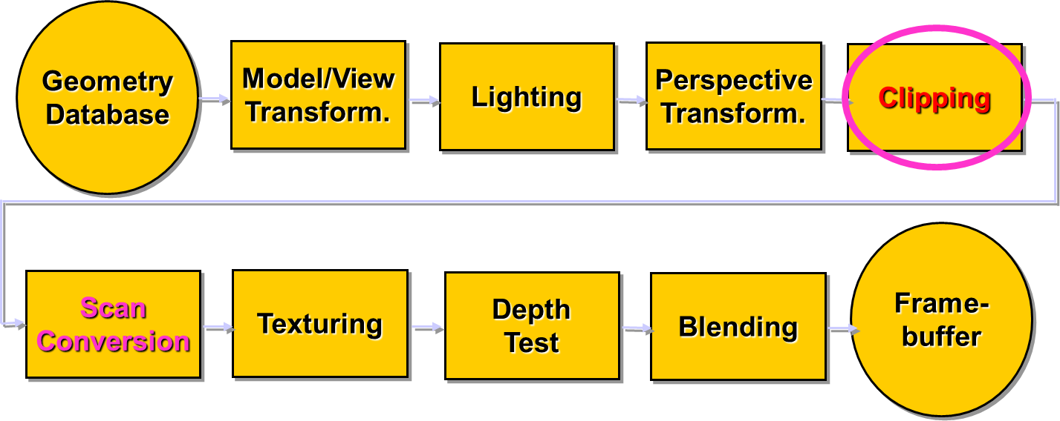
Overview
At end of the geometric pipeline, vertices have been assembled into primitives
Must clip out primitives that are outside the view frustum
Algorithms based on representing primitives by lists of vertices
Must find which pixels can be affected by each primitive
Fragment generation
Rasterization or scan conversion
29

Slide 30
Required Tasks
Clipping
Rasterization or scan conversion
Transformations
Some tasks deferred until fragment processing
Hidden surface removal
Antialiasing
30

Slide 31
Rasterization Meta Algorithms
Consider two approaches to rendering a scene with opaque objects
For every pixel, determine which object that projects on the pixel is closest to the viewer and compute the shade of this pixel (image based)
Ray tracing paradigm
For every object, determine which pixels it covers and shade these pixels (object based)
Pipeline approach
Must keep track of depths (z buffer)
31

Slide 32
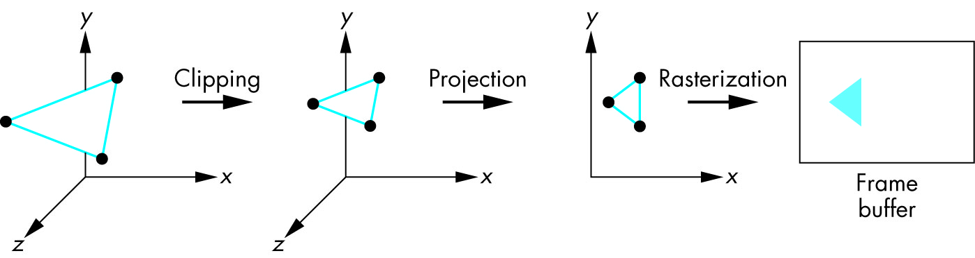
Rasterization Meta Algorithms Object based
For every object, determine which pixels it covers and
shade these pixels (object based)
Pipeline approach
Must keep track of depths
No global information except the z-buffer
32

Slide 33
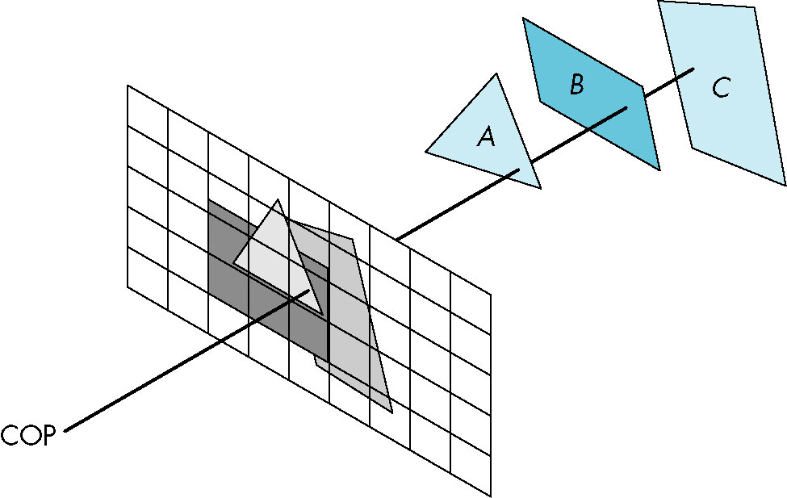
Rasterization Meta Algorithms Image based
For every pixel, determine which object that projects on the pixel is closest to the viewer and compute the shade of this pixel (image based)
Ray tracing paradigm (casting)
Global information needed (database of all objects)
33

Slide 34
Objectives
Introduce basic implementation strategies
Clipping
Scan conversion
34

Slide 35
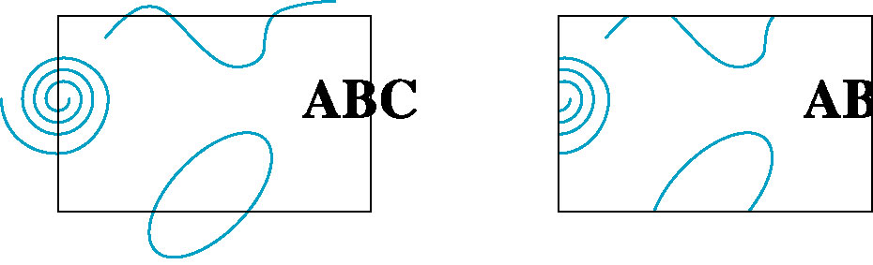
Clipping
glFrustum(...)
alter w
Clipping done BEFORE perspective division to ELIMINATE UNNECESSARY /w
projection
transformation
clipping
/ w
perspective
division
NDCS
normalized
device
35
Clipping window: Part of the scene we want to draw on the screen.
Notes:
We can now turn to clipping, the process of determining which primitives, or parts of primitives, fit within the clipping or view volume defined by the application program. Clipping is done before the perspective division that is necessary if the w component of a clipped vertex is not equal to 1. The portions of all primitives that can possibly be displayed we have yet to apply hidden- surface removal lie within the cube as follows: - w = x = w, - w = y = w, - w = z = w. This coordinate system is called clip coordinates, and it depends on neither the orig-inal application units nor the particulars of the display device, although the infor-mation to produce the correct image is retained in this coordinate system. Note also that projection has been carried out only partially. We still must do the perspective division and the final orthographic projection. After perspective division, we have a three- dimensional representation in normalized device coordinates. By carrying our clipping in clip coordinates, we avoid doing the perspective division for primitives that lie outside the clipping volume. We will concentrate on clipping of line segments and polygons because they are the most common primitives to pass down the pipeline. Although the OpenGL pipeline does clipping on three- dimensional objects, there are other systems in which the objects are first projected into the x, y plane. Fortunately, many of the most efficient algorithms are almost identical in two and three dimensions and we will focus on these algorithms.

Slide 36
Clipping
2D against Clipping window
3D against Clipping volume
Easy for line segments & polygons
Hard for curves and text
Convert to lines and polygons first
Clipping window: Part of the scene we want to draw on the screen.
36
http://www.netgraphics.sk/clipping-polygons-applet
Angel: Interactive Computer Graphics 5E © Addison-Wesley 2009
Notes:
We can now turn to clipping, the process of determining which primitives, or parts of primitives, fit within the clipping or view volume defined by the application program.
Clipping is done before the perspective division that is necessary if the w component of a clipped vertex is not equal to 1.
The portions of all primitives that can possibly be displayed we have yet to apply hidden- surface removal lie within the cube as follows: - w = x = w, - w = y = w, - w = z = w.
This coordinate system is called clip coordinates, and it depends on neither the original application units nor the particulars of the display device, although the information to produce the correct image is retained in this coordinate system.
Note also that projection has been carried out only partially. We still must do the perspective division and the final orthographic projection. After perspective division, we have a three- dimensional representation in normalized device coordinates. By carrying our clipping in clip coordinates, we avoid doing the perspective division for primitives that lie outside the clipping volume. We will concentrate on clipping of line segments and polygons because they are the most common primitives to pass down the pipeline. Although the OpenGL pipeline does clipping on three- dimensional objects, there are other systems in which the objects are first projected into the x, y plane. Fortunately, many of the most efficient algorithms are almost identical in two and three dimensions and we will focus on these algorithms.

Slide 37
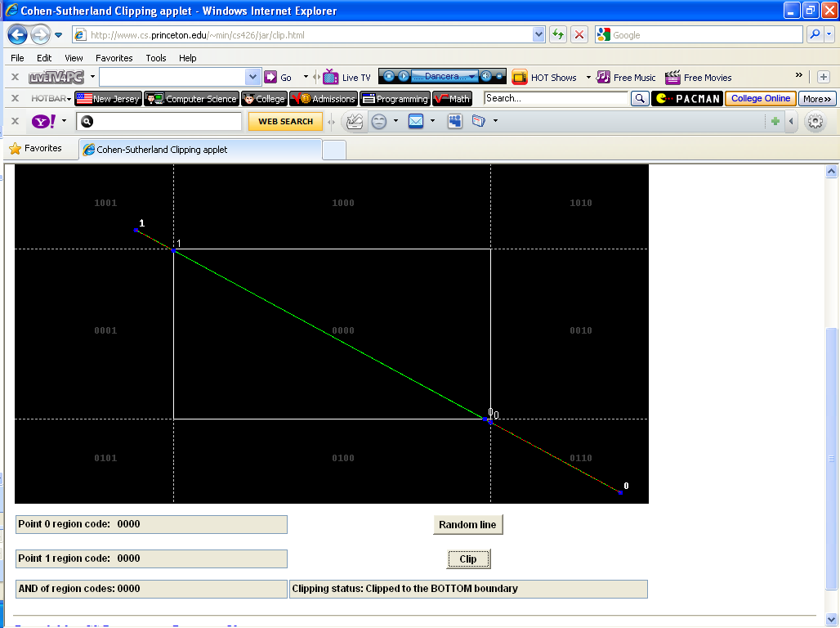
Cohen-Sutherland Line Clipping Applet
37
http://www.cs.princeton.edu/~min/cs426/jar/clip.html
Angel: Interactive Computer Graphics 5E © Addison-Wesley 2009

Slide 38
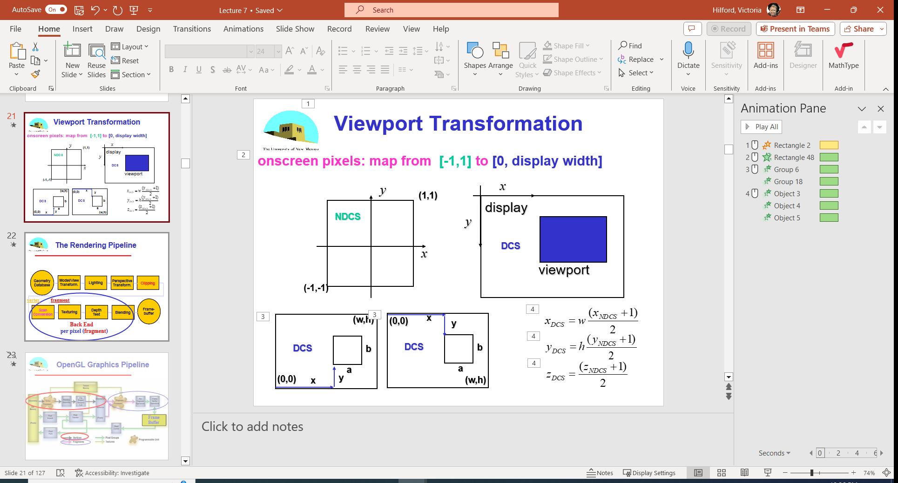
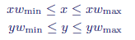
Clipping Points
Clipping a point (x, y) is easy assuming that the clipping window is an axis aligned rectangle defined by and
Keep point (x, y) if
otherwise clip the point.
Using normalized coordinates, we have
and
x
y
P (x,y)
CLASS PARTICIPATION 1!
(Next Slide)
38

Slide 39
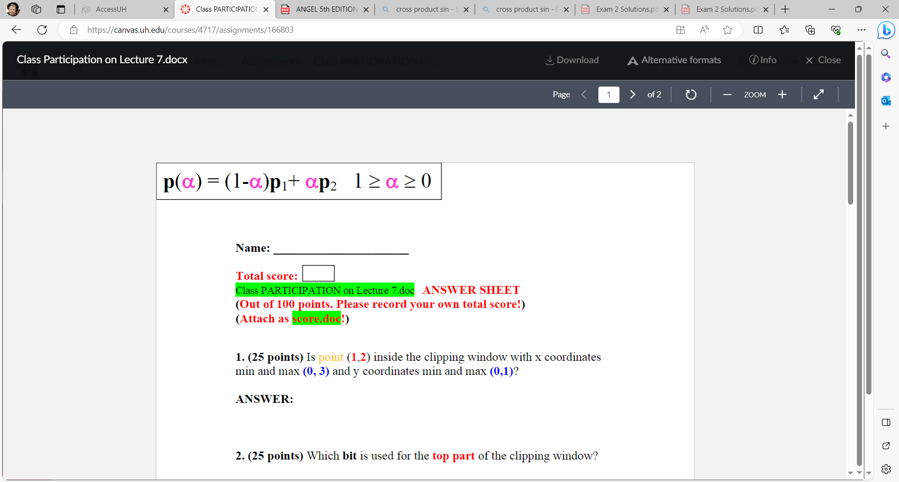
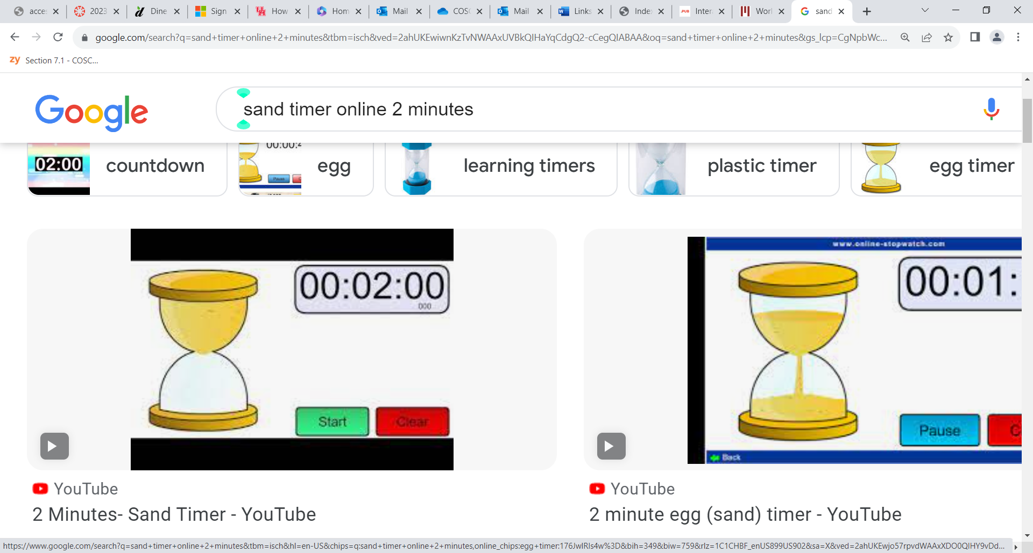
NO
Self Graded - correctly
P (1,2)
(3, 1)
P (x,y)
(0, 0)

Slide 40
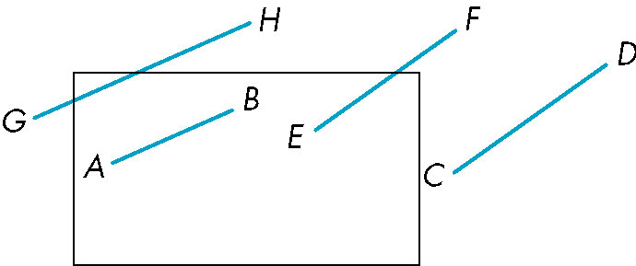
Clipping 2D Line Segments
FUN !!!
Brute force approach: compute intersections with all sides of clipping window
Inefficient: one division per intersection
α = (y2 – y1) / (y_{max} – y1)
p₁ = (x₁, y₁)
p₂ = (x₂, y₂)
p₂
y_{max}
p₁
40
Notes:
A clipper decides which primitives, or parts of primitives, can possibly appear on the display and are passed on to the rasterizer. Primitives that fit within the specified view volume pass through the clipper, or are accepted. Primitives that cannot appear on the display are eliminated, or rejected or culled. Primitives that are only partially within the view volume must be clipped such that any part lying outside the volume is removed. Clipping can occur at one or more places in the viewing pipeline. The modeler may clip to limit the primitives that the hardware must handle. The primitives may be clipped after they have been projected from three- to two- dimensional objects. In OpenGL, primitives are clipped against a three- dimensional view volume before rasterization. We will develop a sequence of clippers. For both pedagogic and his-toric reasons, we start with two two- dimensional line- segment clippers. Both extend directly to three dimensions and to clipping of polygons.

Slide 41
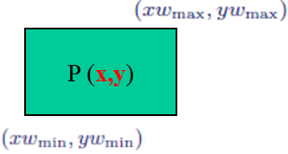
Cohen-Sutherland Algorithm
Idea: eliminate as many cases as possible without computing intersections
Start with four lines that determine the sides of the clipping window
y = y_{max}
x = x_{min}
x = x_{max}
y = y_{min}
41
http://www.cs.princeton.edu/~min/cs426/jar/clip.html
Notes:
7.4.1 Cohen- Sutherland Clipping
The two-dimensional clipping problem for line segments is shown in Figure 7.5. We can assume for now that this problem arises after three-dimensional line segments have been projected onto the projection plane, and that the window is part of the projection plane that is mapped to the viewport on the display.
All values are specified as real numbers. We can see that the entire line segment AB appears on the display, whereas none of CD appears. EF andGHhave to be shortened before being displayed. Although a line segment is completely determined by its endpoints, GH shows that, even if both endpoints lie outside the clipping window, part of the line segment may still appear on the display. We could compute the intersections of the lines of which the segments are parts with the sides of the window, and thus could determine the necessary information for clipping. However, we want to avoid intersection calculations, if possible, because each intersection requires a floating- point division. The Cohen- Sutherland algorithm was the first to seek to replace most of the expensive floating- point multiplications and divisions with a combination of floating- point subtractions and bit operations. The algorithm starts by extending the sides of the window to infinity, thus break-ing up space into the nine regions shown in Figure 7.6. Each region can be assigned a unique 4- bit binary number, or outcode, b0b1b2b3, as follows. Suppose that ( x, y) is a point in the region; then, Likewise, b1 is 1 if y < ymin, and b2 and b3 are determined by the relationship between x and the left and right sides of the window. The resulting codes are indicated in Figure 7.7. For each endpoint of a line segment, we first compute the endpoints outcode, a step that can require eight floating- point subtractions per line segment. Consider a line segment whose outcodes are given by o1 = outcode( x1, y1) and o2 = outcode( x2, y2). We can now reason on the basis of these outcodes. There are four cases: 1. ( o1 = o2 = 0.) Both endpoints are inside the clipping window, as is true for

Slide 42
The Cases
Case 1: both endpoints of line segment inside all four lines
Draw (accept) line segment as is
Case 2: both endpoints of line segment outside all lines and on same side of a line
Discard (reject) the line segment
y = y_{max}
x = x_{min}
x = x_{max}
y = y_{min}
42
Notes:
There are four cases:
1. ( o1 = o2 = 0.) Both endpoints are inside the clipping window, as is true for
2. ( o1 = 0, o2 = 0; or vice versa.) One endpoint is inside the clipping window; one is outside ( see segment CD in Figure 7.7). The line segment must be shortened. The nonzero outcode indicates which edge, or edges, of the window are crossed by the segment.
One or two intersections must be computed. Note that after one intersection is computed, we can compute the outcode of the point of intersection to determine whether another intersection calculation is required.

Slide 43
The Cases
Case 3: One endpoint inside, one outside
Must do at least one intersection
Case 4: Both outside
May have part inside
Must do at least one intersection
y = y_{max}
x = x_{min}
x = x_{max}
43
Notes:
3. ( o1 & o2 = 0.) By taking the bitwise and of the outcodes, we determine whether or not the two endpoints lie on the same outside side of the window. If so, the line segment can be discarded ( see segment EF in Figure 7.7).
4. ( o1 & o2 = 0.) Both endpoints are outside, but they are on the outside of different edges of the window.
As we can see from segments GH and IJ in Figure 7.7, we cannot tell from just the outcodes whether the segment can be discarded or must be shortened. The best we can do is to intersect with one of the sides of the window, and to check the outcode of the resulting point.

Slide 44
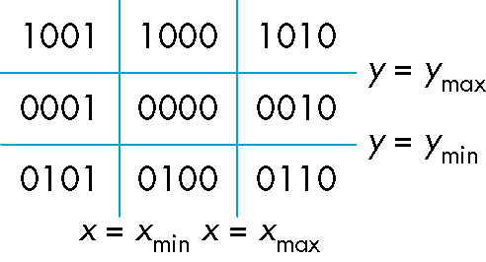
Defining Outcodes
For each endpoint, define an outcode
Outcodes divide space into 9 regions
Computation of outcode requires at most 4 subtractions
b₀b₁b₂b₃
1
1
1
above
b₀ = 1 if y > y_{max}, 0 otherwise
b₁ = 1 if y < y_{min}, 0 otherwise
b₂ = 1 if x > x_{max}, 0 otherwise
b₃ = 1 if x < x_{min}, 0 otherwise
01
01
01
below
CLASS PARTICIPATION 2!
(Next Slide)
44

Slide 45
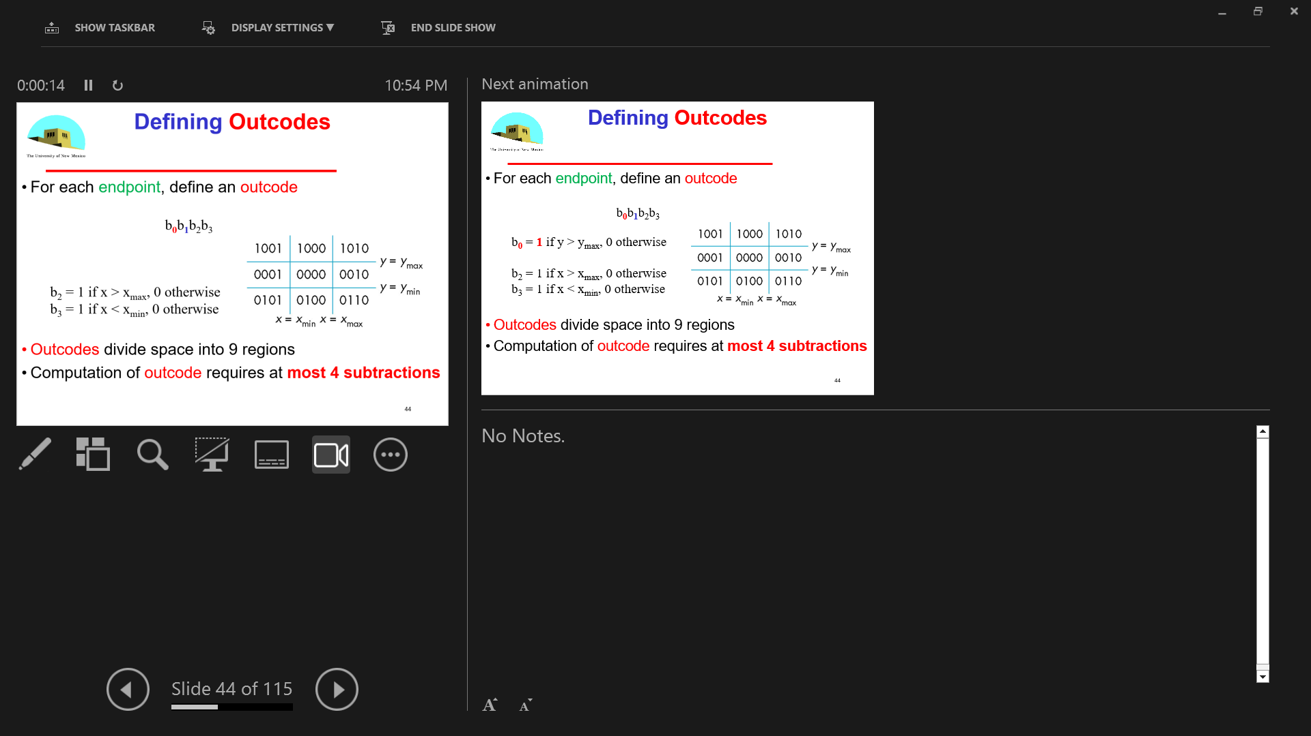
Self Graded - correctly
b₀

Slide 46
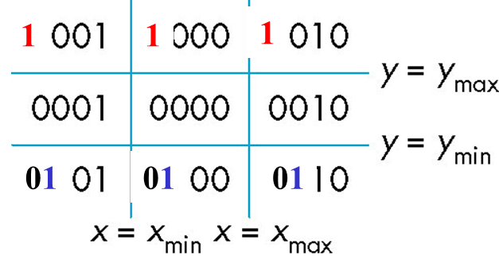
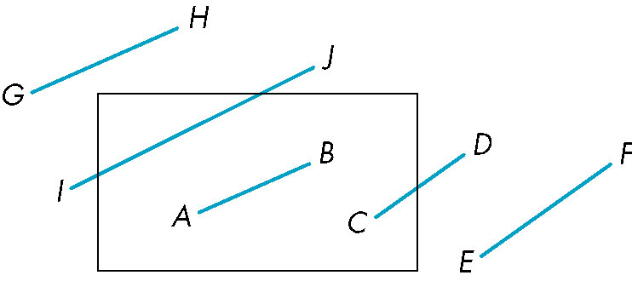
Using Outcodes
Consider the 5 cases below
AB: outcode(A) = outcode(B) = 0
Accept line segment
46

Slide 47

Using Outcodes
CD: outcode (C) = 0, outcode(D) ≠ 0
Compute intersection
Location of 1 in outcode(D) determines which edge to intersect with
Note if there were a segment from A to a point in a region with 2 ones in outcode, we might have to do 2 intersections
47

Slide 48
Using Outcodes
EF: outcode(E) logically ANDed with outcode(F) (bitwise) ≠ 0
Both outcodes have a 1 bit in the same place
Line segment is outside of corresponding side of clipping window
reject
48

Slide 49
Using Outcodes
GH and IJ: same outcodes, neither zero but logical AND yields zero
Shorten line segment by intersecting with one of sides of window
Compute outcode of intersection (new endpoint of shortened line segment)
Re-execute algorithm
49

Slide 50
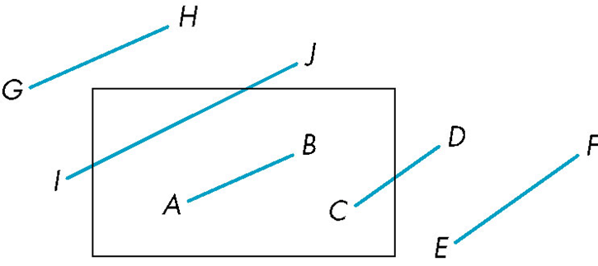
Efficiency
In many applications, the clipping window is small relative to the size of the entire database
Most line segments are outside one or more side of the window and can be eliminated based on their outcodes
Inefficiency when code has to be re-executed for line segments that must be shortened in more than one step
50

Slide 51
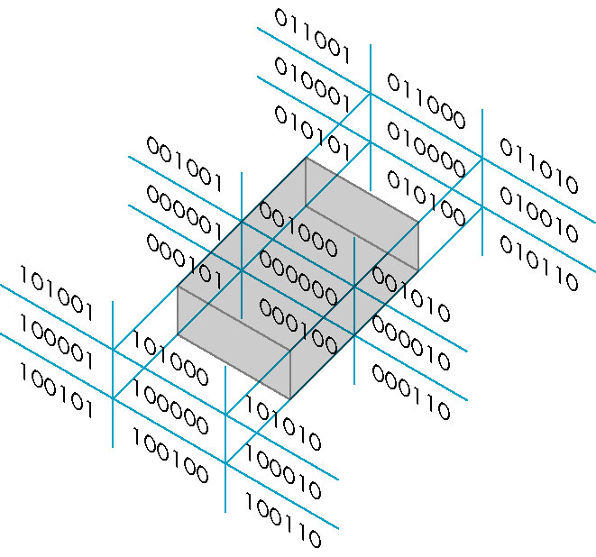
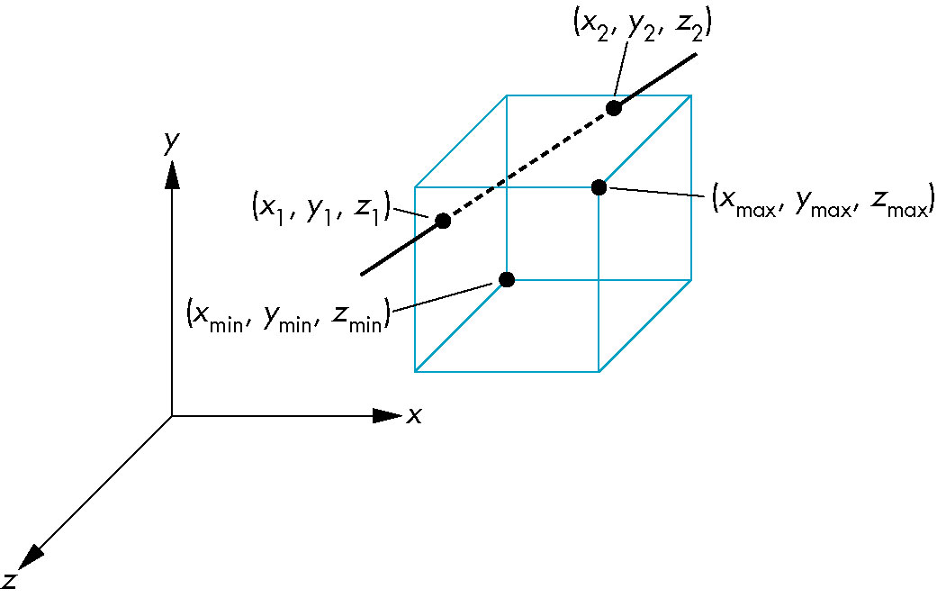
Cohen Sutherland in 3D
Use 6-bit outcodes ( 6 faces!)
When needed, clip line segment against planes
51

Slide 52
Liang-Barsky Clipping
Consider the parametric form of a line segment
We can distinguish between the cases by looking at the ordering of the values of α where the line determined by the line segment crosses the lines that determine the window (e.g., y = y _{max} for the top window edge)
y = y_{max}
p₂
p₁
CLASS PARTICIPATION 3!
(Next Slide)
52
Notes:
7.4.2 Liang- Barsky Clipping If we use the parametric form for lines, we can approach the clipping of line segments in a different and ultimately more efficient manner.
Suppose that we have a line segment defined by the two endpoints p1 = [ x1, y1] T and p2 = [ x2, y2] T.
We can use these endpoints to define a unique line that we can express parametrically, either in matrix form, p( a) = ( 1- a) p1 + ap2, or as two scalar equations, x( a) = ( 1- a) x1 + ax2, y( a) = ( 1- a) y1 + ay2. Note that this form is robust and needs no changes for horizontal or vertical lines. As the parameter a varies from 0 to 1, we move along the segment from p1 to p2. Negative values of a yield points on the line on the other side of p1 from p2. Similarly, values of a > 1 give points on the line past p2 going off to infinity. Consider the line segment and the line of which it is part, as shown in Figure 7.8( a). As long as the line is not parallel to a side of the window ( if it is, we can handle that situation with ease), there are four points where the line intersects the extended sides of the window. These points correspond to the four values of the parameter: a1, a2, a3, and a4. One of these values corresponds to the line entering the window; another corresponds to the line leaving the window. Leaving aside, for the moment, how we compute these intersections, we can order them, and can determine which correspond to intersections that we need for clipping. For the given example, 1> a4 > a3 > a2 > a1 > 0.
Hence, all four intersections are inside the original line segment, with the two innermost ( a2 and a3) determining the clipped line segment. We can distinguish this case from the case in Figure 7.8( b), which also has the four intersections between the endpoints of the line segment, by noting that the order for this case is 1> a4 > a2 > a3 > a1 > 0. The line intersects both the top and the bottom of the window before it intersects either the left or the right; thus, the entire line segment must be rejected. Other cases of the ordering of the points of intersection can be argued in a similar way. Efficient implementation of this strategy requires that we avoid computing inter-sections until they are needed. Many lines can be rejected before all four intersections are known. We also want to avoid floating- point divisions where possible. If we use the parametric form to determine the intersection with the top of the window, we find the intersection at the value a = ymax - y1 y2 - y1 . Similar equations hold for the other three sides of the window. Rather than computing these intersections, at the cost of a division for each, instead we write the equation as a( y2 - y1) = a y = ymax - y1 = ymax.
All the tests required by the algorithm can be restated in terms of ymax, y, and similar terms can be computed for the other sides of the windows. Thus, all decisions about clipping can be made without floating- point division. Only if an intersection is needed ( because a segment has to be shortened) is the division done. The efficiency of this approach, compared to that of the Cohen- Sutherland algorithm, is that we avoid multiple shortening of line segments and the related reexecutions of the clipping algorithm.
We forgo discussion of other efficient two- dimensional line- clipping algorithms because, unlike the Cohen- Sutherland and Liang- Barsky algorithms, these algorithms do not extend to three dimensions.

Slide 53
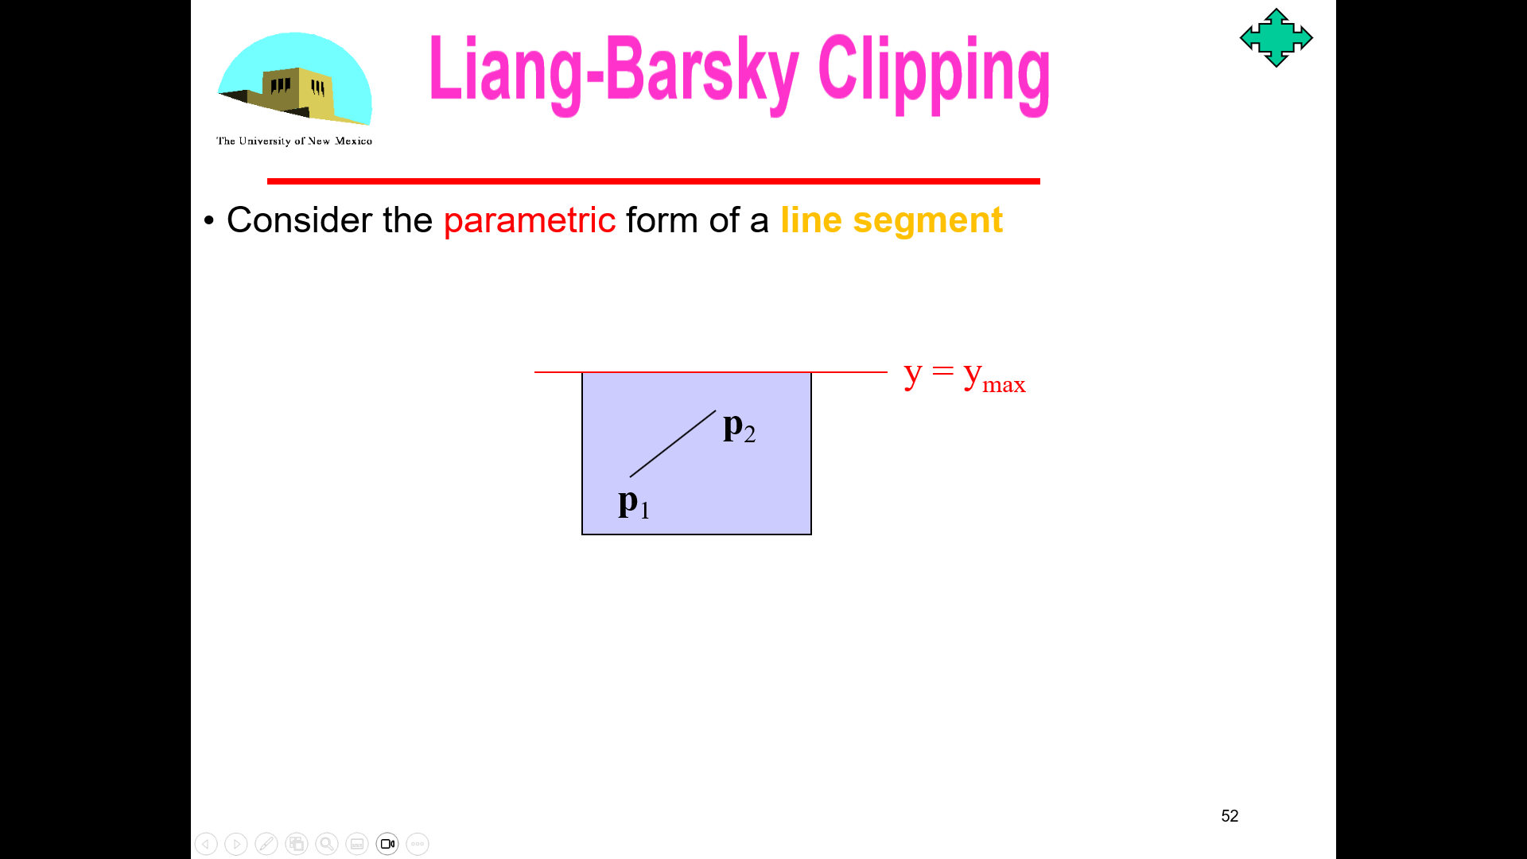
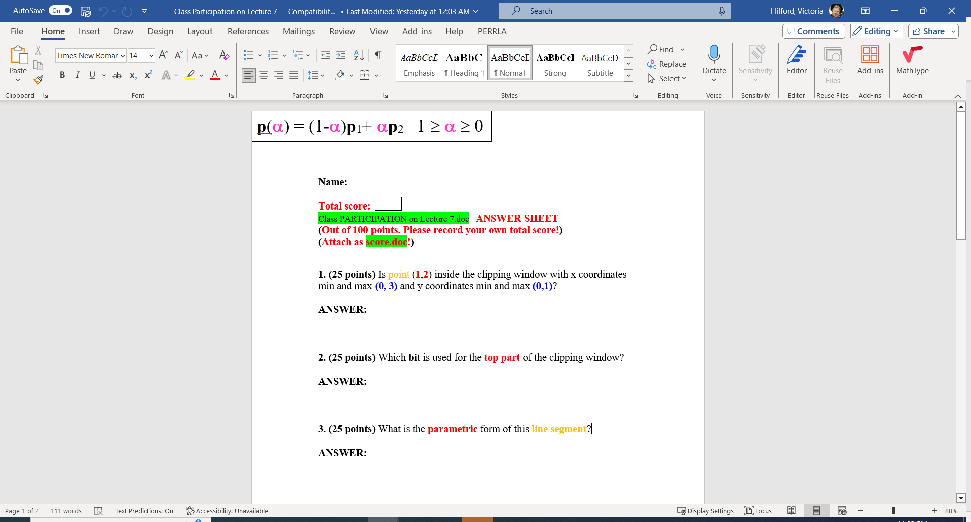
Self Graded - correctly
p(α) = (1-α)p₁+ αp₂ 1 ≥ α ≥ 0

Slide 54
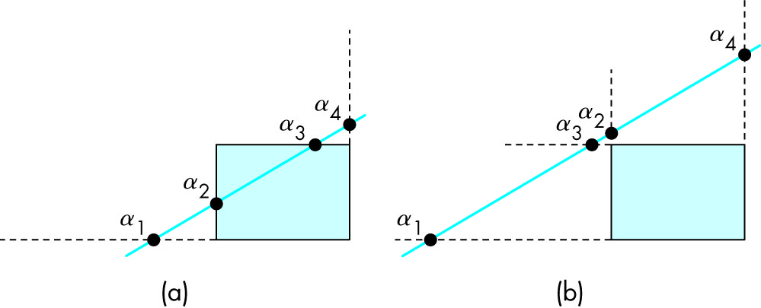
Liang-Barsky Clipping
In (a): α₄ > α₃ > α₂ > α₁
Intersect right, top, left, bottom: shorten (α2 α3)
In (b): α₄ > α₂ > α₃ > α₁
Intersect right, left, top, bottom: reject
54

Slide 55
Liang-Barsky Advantages
Can accept/reject as easily as with Cohen-Sutherland
Using values of α, we do not have to use algorithm recursively as with Cohen-Sutherland
Extends to 3D
55

Slide 56
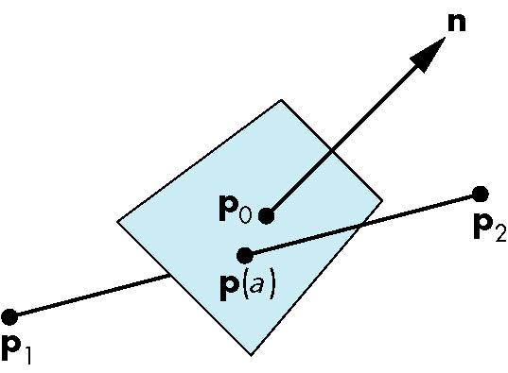
Plane-Line Intersections
Line segment between P₁ and P₂ parametric α form
P(α) = P₁ + α (P₂ – P₁)
Plane equation n ● a = 0 n ● (P(α) – P₀) = 0
What is α for the point of intersection?
a
P₂
P(α)
P₁
56

Slide 57
Plane-Line Intersections
n
p₀
p₂
P(α)
p₁
CLASS PARTICIPATION 4!
(Next Slide)
57

Slide 58
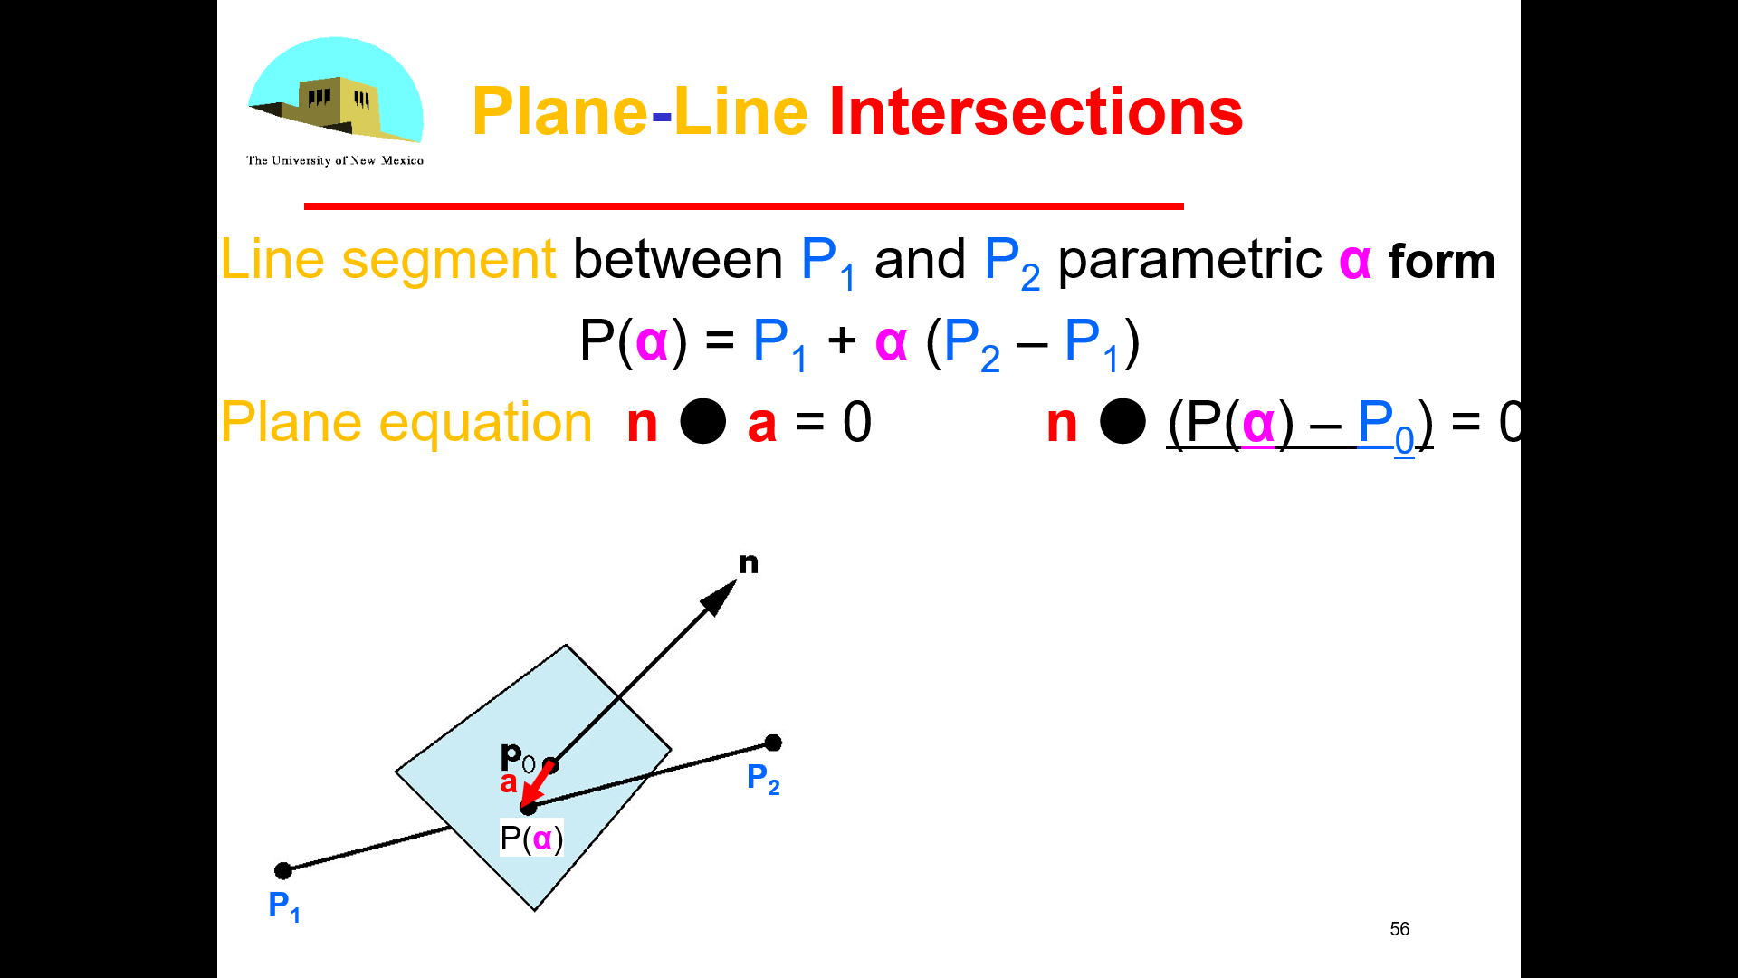
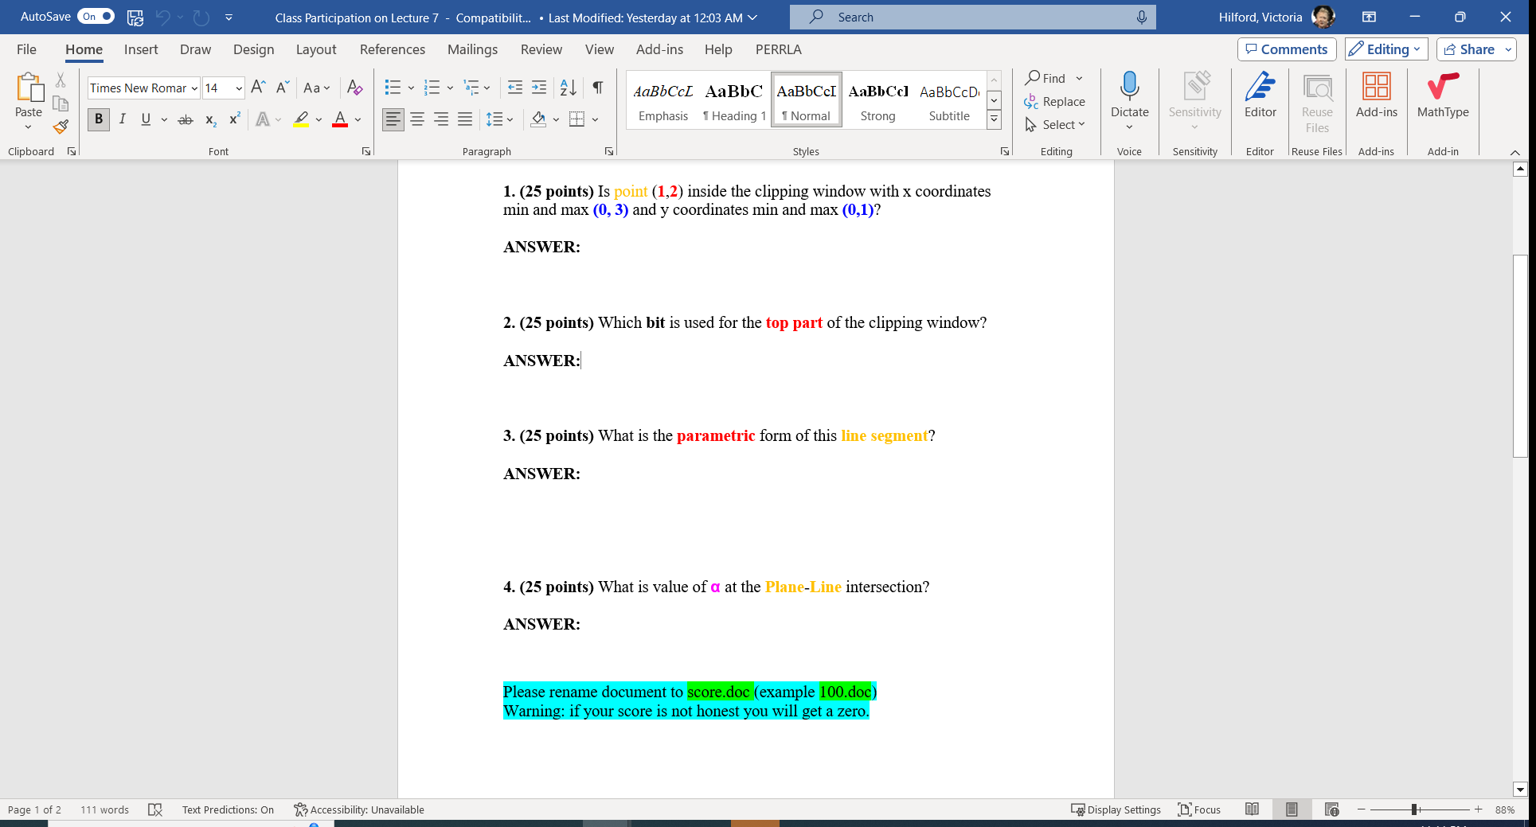
0
Self Graded - correctly

Slide 59
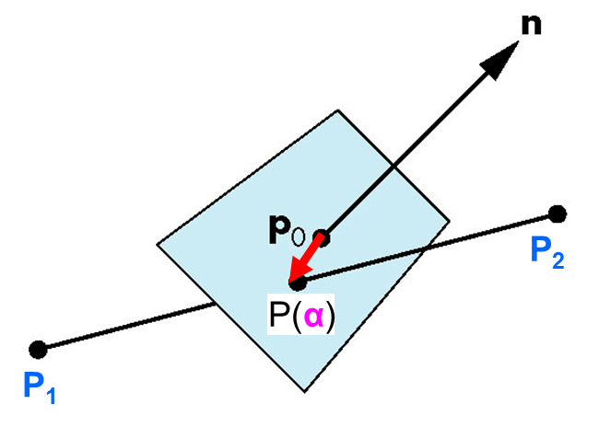
Plane-Line Intersections
P(α) = P₁ + α (P₂ – P₁)
n ● (P(α) – P₀) = 0
What is α for the point of intersection?
n ● (P₁ + α (P₂ – P₁) – P₀) = 0
α
n ● ( (P₁ – P₀) + α (P₂ – P₁) ) = 0
n ● (P₁ – P₀) + α n ● (P₂ – P₁) ) = 0
n ● (P₀ – P₁) = α n ● (P₂ – P₁) )
59

Slide 60
Implementation II
60

Slide 61
Objectives
Introduce clipping algorithms for polygons
Survey hidden-surface algorithms
61
Notes:
7.5 POLYGON CLIPPING
Polygon clipping arises in a number of ways. Certainly, we want to be able to clip polygons against rectangular windows for display. However, at times we may want windows that are not rectangular. Other parts of an implementation, such as shadow generation and hidden- surface removal, can require clipping of polygons against other polygons. For example, Figure 7.9 shows the shadow of a polygon that we create by clipping a polygon that is closer to the light source against polygons that are farther away.
Many antialiasing methods rely on our ability to clip polygons against other polygons. We can generate polygon- clipping algorithms directly from line- clipping algorithms by clipping the edges of the polygon successively. However, we must be careful to remember that a polygon is a two- dimensional object with an interior, and depending on the form of the polygon, we can generate more than one polygonal object by clipping. Consider the nonconvex ( or concave) polygon shown in Figure 7.10( a). If we clip it against a rectangular window, we get the result shown in Figure 7.10( b). Most viewers looking at this figure would conclude that we have generated three polygons by clipping. Unfortunately, implementing a clipper that can increase the number of objects can be a problem. We could treat the result of the clipper as a single polygon, as shown in Figure 7.11, with edges that overlap along the sides of the window, but this choice might cause difficulties in other parts of the implementation. Convex polygons do not present such problems. Clipping a convex polygon against a rectangular window can leave at most a single convex polygon ( see Exercise 7.3). A graphics system might then either forbid the use of concave polygons, or divide ( tessellate)

Slide 62
Objectives
Introduce clipping algorithms for polygons
Chapter 7.5
Survey hidden-surface algorithms
62
Notes:
7.5 POLYGON CLIPPING Polygon clipping arises in a number of ways. Certainly, we want to be able to clip polygons against rectangular windows for display. However, at times we may want windows that are not rectangular. Other parts of an implementation, such as shadow generation and hidden- surface removal, can require clipping of polygons against other polygons. For example, Figure 7.9 shows the shadow of a polygon that we create by clipping a polygon that is closer to the light source against polygons that are farther away. Many antialiasing methods rely on our ability to clip polygons against other polygons. We can generate polygon- clipping algorithms directly from line- clipping algo-rithms by clipping the edges of the polygon successively. However, we must be care-ful to remember that a polygon is a two- dimensional object with an interior, and depending on the form of the polygon, we can generate more than one polygonal object by clipping. Consider the nonconvex ( or concave) polygon shown in Fig-ure 7.10( a). If we clip it against a rectangular window, we get the result shown in Figure 7.10( b). Most viewers looking at this figure would conclude that we have gen-erated three polygons by clipping. Unfortunately, implementing a clipper that can increase the number of objects can be a problem. We could treat the result of the clipper as a single polygon, as shown in Figure 7.11, with edges that overlap along the sides of the window, but this choice might cause difficulties in other parts of the implementation. Convex polygons do not present such problems. Clipping a convex polygon against a rectangular window can leave at most a single convex polygon ( see Exercise 7.3). A graphics system might then either forbid the use of concave polygons, or divide ( tessellate)

Slide 63
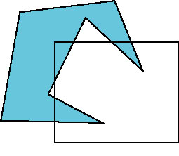
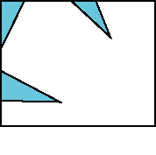
Polygon Clipping
Not as simple as line segment clipping
Clipping a line segment yields at most one line segment
Clipping a polygon can yield multiple polygons
However, clipping a convex polygon can yield at most one other polygon
63
Notes:
7.5 POLYGON CLIPPING
Polygon clipping arises in a number of ways.
Certainly, we want to be able to clip polygons against rectangular windows for display. However, at times we may want windows that are not rectangular. Other parts of an implementation, such as shadow generation and hidden- surface removal, can require clipping of polygons against other polygons. For example, Figure 7.9 shows the shadow of a polygon that we create by clipping a polygon that is closer to the light source against polygons that are farther away. Many antialiasing methods rely on our ability to clip polygons against other polygons. We can generate polygon- clipping algorithms directly from line- clipping algorithms by clipping the edges of the polygon successively. However, we must be careful to remember that a polygon is a two- dimensional object with an interior, and depending on the form of the polygon, we can generate more than one polygonal object by clipping. Consider the nonconvex ( or concave) polygon shown in Figure 7.10( a). If we clip it against a rectangular window, we get the result shown in Figure 7.10( b). Most viewers looking at this figure would conclude that we have generated three polygons by clipping. Unfortunately, implementing a clipper that can increase the number of objects can be a problem. We could treat the result of the clipper as a single polygon, as shown in Figure 7.11, with edges that overlap along the sides of the window, but this choice might cause difficulties in other parts of the implementation.

Slide 64
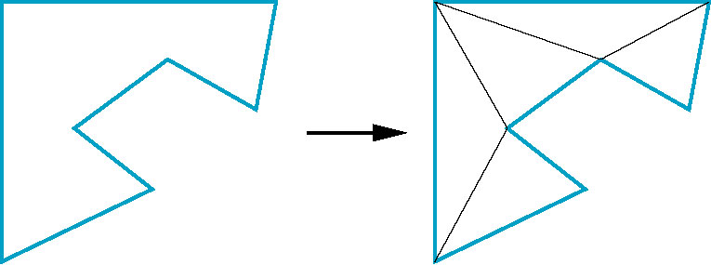
Tessellation and Convexity
One strategy is to replace nonconvex (concave) polygons with a set of triangular polygons (a tessellation)
Also makes fill easier
Tessellation code in GLU library
64
Notes:
Convex polygons do not present such problems.
Clipping a convex polygon against a rectangular window can leave at most a single convex polygon
( see Exercise 7.3).
A graphics system might then either forbid the use of concave polygons, or divide (tessellate) a given polygon into a set of convex polygons, as shown in Figure 7.12.1

Slide 65
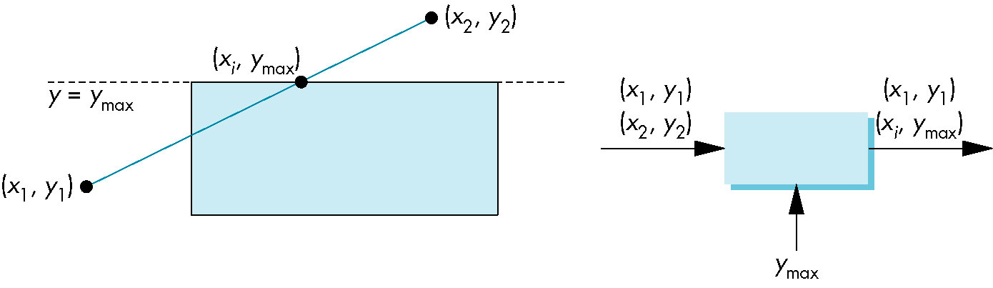
Clipping as a Black Box
Can consider line segment clipping as a process that takes in two vertices (x₁, y₁) & (x₂,y₂) and produces either no vertices or the vertices of a clipped line segment (x₁, y₁) & (x_{i},y_{max})
y_{max}
y_{max}
65
Notes:
A line-segment clipper can be envisioned as a black box ( Figure 7.13) whose input is the pair of vertices from the segment to be tested and clipped, and whose output either is a pair of vertices corresponding to the clipped line segment or is nothing if the input line segment lies outside the window.
Rather than considering the clipping window as four-line segments, we can consider it as the object created by the intersection of four infinite lines that determine the top, bottom, right, and left sides of the window. We can then subdivide our clip-per into a pipeline of simpler clippers, each of which clips against a single line that is the extension of an edge of the window. We can use the black- box view on each of the individual clippers.

Slide 66
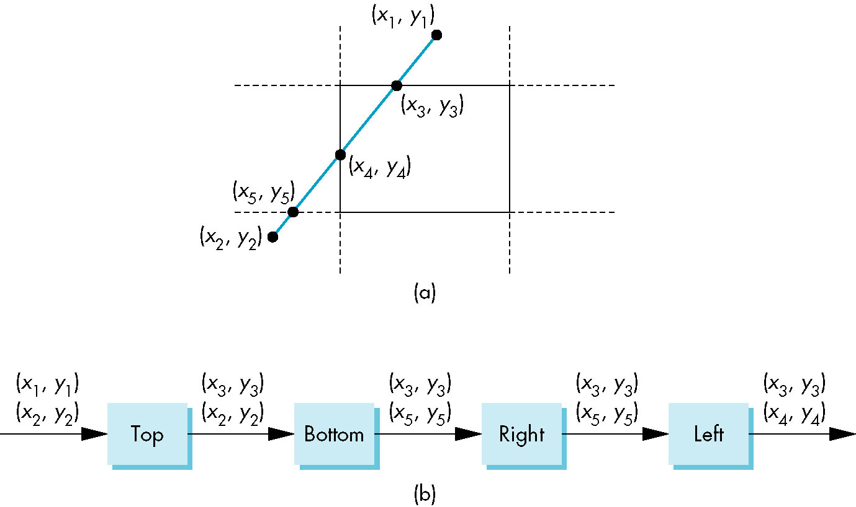
Pipeline Clipping of Line Segments
Clipping against each side of window is independent of other sides
Can use four independent clippers in a pipeline
x₃ = x(α) = x1 + α (x₂ – x₁)
y₃ = y _{max} = y(α) = y₁ + α (y₂ – y₁)
α = (y₂ – y₁) / (y_{max} – y₁)
(x₃, y_{max})
Knowing α allows us to get x coordinate of
the intersection point:
x₃ = x₁ + α (x₂ – x₁) =
= x₁ + (y₂ – y₁) / (y_{max} – y₁) (x₂ – x₁)
66

Slide 67
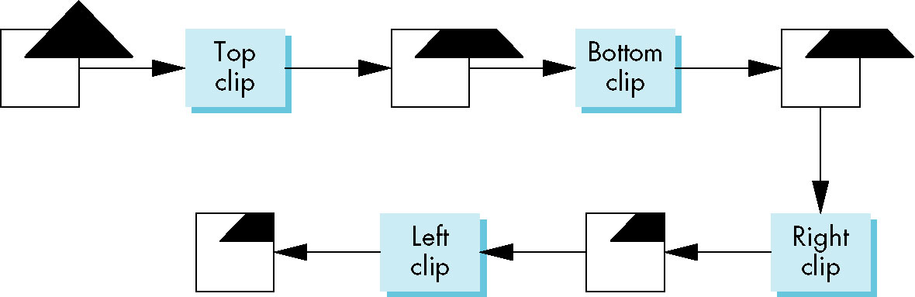
Pipeline Clipping of Polygons
Three dimensions: add front and back clippers
Strategy used in SGI Geometry Engine
Small increase in latency
67

Slide 68
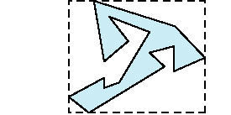
Bounding Boxes
Rather than doing clipping on a complex polygon, we can use an axis-aligned bounding box or extent
Smallest rectangle aligned with axes that encloses the polygon
Simple to compute: max and min of x and y
68
Notes:
7.6 CLIPPING OF OTHER PRIMITIVES
Our emphasis in Chapters 1 through 6 was on writing programs in which the objects are built from line segments and flat polygons.
We often render the curved objects that we discuss in Chapter 12 by subdividing them into small, approximately flat polygons.
In pipeline architectures, we usually find some variant of the clippers that we have presented. Nevertheless, there are situations in which we want either to clip objects before they reach the hardware or to employ algorithms optimized for other primitives.

Slide 69
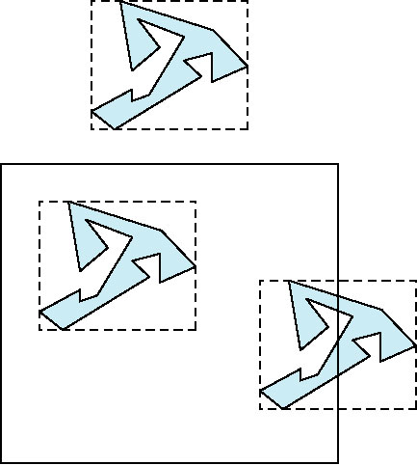
Bounding boxes
Can usually determine accept/reject based only on bounding box
reject
accept
requires detailed
clipping
69
Notes:
7.6.1 Bounding Boxes and Volumes Suppose that we have a many-sided polygon, as shown in Figure 7.18( a).
We could apply one of our clipping algorithms, which would clip the polygon by individually clipping all that polygons edges. However, we can see that the entire polygon lies outside the clipping window. We can exploit this observation through the use of the axis- aligned bounding box or extent of the polygon ( Figure 7.18( b)): the smallest rectangle, aligned with the window, that contains the polygon.
Calculating the bounding box requires only going through the vertices of the polygon to find the minimum and maximum of both the x and y values. Once we have the bounding box, we can often avoid detailed clipping. Consider the three cases shown in Figure 7.19. For the polygon above the window, no clipping is necessary, because the minimum y for the bounding box is above the top of the window. For the polygon inside the window, we can determine that it is inside by comparing the bounding box with the window. Only when we discover that the bounding box straddles the window do we have to carry out detailed clipping, using all the edges of the polygon. The use of extents is such a powerful technique in both two and three dimensions that modeling systems often compute a bounding for each object, automatically, and store the bounding box with the object. Axis- aligned bounding boxes work in both two and three dimensions. In three dimensions, they can be used in the application to perform clipping to reduce the burden on the pipeline. Other volumes, such as spheres, can also work well. One of the other applications of bounding volumes is in collision detection ( Chapter 12). One of the fundamental operations in animating computer games is to determine if two moving entities have collided. For example, consider two animated characters moving in a sequence of images. We need to know when they collide so that we can alter their paths. This problem has many similarities to the clipping problem because we want to determine when the volume of one intersects the volume of the other. The complexity of the objects and the need to do these calculations very quickly make this problem difficult. A common approach is to place each object in a bounding volume, either an axis- aligned bounding box or a sphere, and to determine if the volumes intersect. If they do, then detailed calculations can be done.

Slide 70
Objectives
Introduce clipping algorithms for polygons
Survey hidden-surface algorithms
Chapter 7.11
70

Slide 71
Clipping and Visibility
Clipping has much in common with hidden-surface removal
In both cases, we are trying to remove objects that are not visible to the camera
Often, we can use visibility or occlusion testing early in the process to eliminate as many polygons as possible before going through the entire pipeline
71
Notes:
The study of hidden- surface removal algorithms clearly illustrates the variety of available algorithms, the differences between working with objects and working with images, and the importance of evaluating the incremental effects of successive algorithms in the implementation process.
Consider a scene composed of k three-dimensional opaque flat polygons, each of which we can consider to be an individual object. We can derive a generic object-space approach by considering the objects pairwise, as seen from the center of projection. Consider two such polygons, A and B. There are four possibilities ( Figure 7.39):

Slide 72
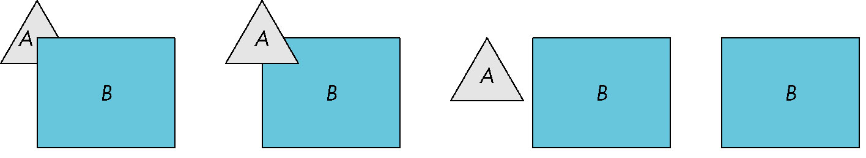
Hidden Surface Removal
Object-space approach: use pairwise testing between polygons (objects)
Worst case complexity O(n²) for n polygons
partially obscuring
can draw independently
72
Notes:
A completely obscures B from the camera; we display only A. 2. B obscures A; we display only B. 3. A and B both are completely visible; we display both A and B. 4. A and B partially obscure each other; we must calculate the visible parts of each polygon.
For complexity considerations, we can regard the determination of which case we have and any required calculation of the visible part of a polygon as a single operation. We proceed iteratively. We pick one of the k polygons and compare it pairwise with the remaining k - 1polygons. After this procedure, we know which part ( if any) of this polygon is visible, and we render the visible part. We are now done with this polygon, so we repeat the process with any of the other k - 1 polygons. Each step in-volves comparing one polygon, pairwise, with the other remaining polygons, until we have only two polygons remaining, and we compare them to each other. We can easily determine that the complexity of this calculation is O( k2). Thus, without deriving any of the details of any particular object-space algorithm, we should suspect that the object- space approach works best for scenes that contain relatively few polygons.

Slide 73
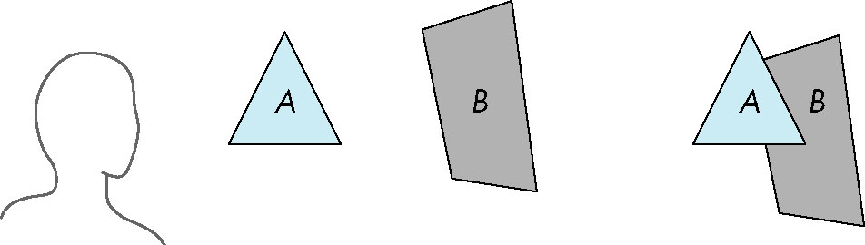
Painter’s Algorithm
Render polygons in a back to front order so that polygons behind others are simply painted over
B behind A as seen by viewer
Fill B then A
73
Notes:
7.11.7 Depth Sort and the Painters Algorithm
Although image- space methods are dominant in hardware due to the efficiency and ease of implementation of the z- buffer algorithm, often object- space methods are used within the application to lower the polygon count. Depth sort is a direct implementation of the object- space approach to hidden- surface removal.
We present the algorithm for a scene composed of planar polygons; extensions to other classes of objects are possible. Depth sort is a variant of an even simpler algorithm known as the painters algorithm.
Suppose that we have a collection of polygons that is sorted based on how far from the viewer the polygons are.
For the example illustrated in Figure 7.51( a), we have two polygons. To a viewer, they appear as shown in Figure 7.51( b), with the polygon in front partially obscuring the other. To render the scene correctly, we could find the part of the rear polygon that is visible, and could render that part into the frame buffer a calculation that requires clipping one polygon against the other. Or we could use another approach, analogous to the way a painter might render the scene. She probably would paint the rear polygon in its entirety, and then the front polygon, painting over the part of the rear polygon not visible to the viewer in the process. Both polygons would be rendered completely, with the hidden- surface removal being done as a consequence of the back- to- front rendering of the polygons. 9 The two questions related to this algorithm are how to do the sort, and what to do if polygons overlap. Depth sort addresses both, although in many applications more efficiencies can be found ( see, for example, Exercise 7.10).

Slide 74
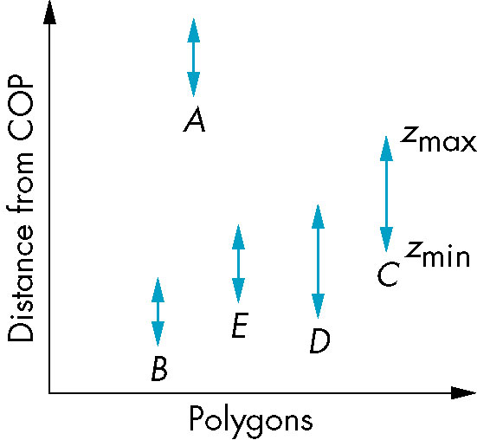
Depth Sort
Requires ordering of polygons first
O(n log n) calculation for ordering
Not every polygon is either in front or behind all other polygons
Order polygons and deal with
easy cases first, harder later
Polygons sorted by
distance from COP
74
Notes:
Suppose that we have already computed the extent of each polygon.
The next step of depth sort is to order all the polygons by how far away from the viewer their maximum z- value is.
This step gives the algorithm the name depth sort. Suppose that the order is as shown in Figure 7.52, which depicts the z extents of the polygons after the sort. If the minimum depth the z- value of a given polygon is greater than the maximum depth of the polygon behind the one of interest, we can paint the polygons back to front and we are done. For example, in Figure 7.52, polygon A is behind all FIGURE 7.54 Polygons with overlapping extents. the other polygons and can be painted first. However, the others cannot be painted based solely on the z- extents. If the z- extents of two polygons overlap, we still may be able to find an order to paint ( render) the polygons individually and yield the correct image. The depth- sort algorithm runs a number of increasingly more difficult tests, attempting to find such an ordering. Consider a pair of polygons whose z- extents overlap. The simplest test is to check their x and y- extents ( Figure 7.53). If either of the x or y extents do not overlap, 10 neither polygon can obscure the other, and they can be painted in either order. Even if these tests fail, it may still be possible to find an order in which we can paint the polygons individually. Figure 7.54 shows such a case. All the vertices of one polygon lie on the same side of the plane determined by the other. We can process the vertices ( see Exercise 7.12) of the two polygons to determine whether this case exists.

Slide 75
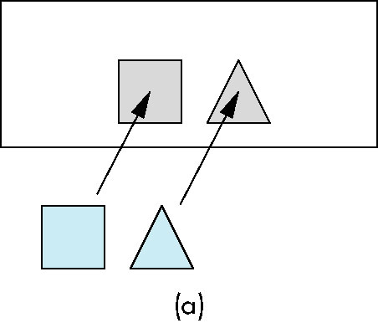
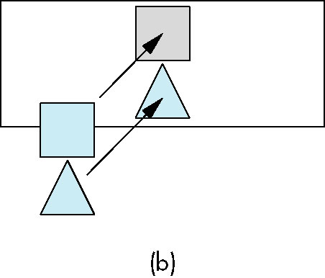
Easy Cases
A lies behind all other polygons
Can render
Polygons overlap in z but not in either x or y
Can render independently
75

Slide 76
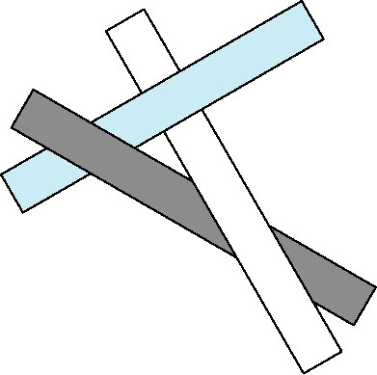


Hard Cases
cyclic overlap
Overlap in all directions
but one is fully on
one side of the other
penetration
76

Slide 77

Back-Face Removal (Culling)
face is visible iff 90 ≥ θ ≥ -90
equivalently cos θ ≥ 0
or v • n ≥ 0
θ
plane of face has form ax + by +cz +d =0
but after normalization n = ( 0 0 1 0)^{T}
need only test the sign of c
In OpenGL we can simply enable culling but may not work correctly if we have nonconvex objects
77
Notes:
7.11.4 Back- Face Removal In Chapter 6, we noted that in OpenGL, we can choose to render only front- facing polygons.
For situations where we cannot see back faces, such as scenes composed of convex polyhedra, we can reduce the work required for hidden- surface removal by eliminating all back- facing polygons before we apply any other hidden- surface removal algorithm. The test for culling a back- facing polygon can be derived from Figure 7.45. We see the front of a polygon if the normal, which comes out of the front face, is pointed toward the viewer. If . is the angle between the normal and the viewer, then the polygon is facing forward if and only if - 90 = . = 90, or, equivalently, cos . = 0. The second condition ismuch easier to test because, instead of computing the cosine, we can use the dot product: n . v >= 0.
We can simplify this test even further if we note that usually it is applied after transfor-mation to normalized device coordinates. In this system, all views are orthographic, with the direction of projection along the z- axis. Hence, in normalized device coor-dinates, v =.. 0 0 1 .. . Thus, if the polygon is on the surface ax + by + cz + d = 0 in normalized device coordinates, we need only to check the sign of c to determine whether we have a front- or back- facing polygon. This test can be implemented easily in either hardware or software; we must simply be careful to ensure that removing back- facing polygons is correct for our application.
In OpenGL, the function glCullFace allows us to turn on back- face elimina-tion. OpenGL takes a different approach to back- face determination. The algorithm is based on computing the area of the polygon in screen coordinates. Consider the polygon shown in Figure 7.46 with n vertices. Its area is given by 1 2 i ( yi+ 1 + yi)( xi+ 1 - xi), where the indices are taken modulo n ( see Exercise 7.28). A negative area indicates a back- facing polygon.

Slide 78
Image Space Approach
Look at each ray projector (nm for an n x m frame buffer) & find closest of k polygons
Intersect ray (projector) with each of the planes determined by our k polygons, and find the intersection closest to the COP.
Complexity O(nmk)
Ray tracing (casting)
z-buffer
pixel
78
Notes:
The image- space approach follows our viewing and ray- casting model, as shown in Figure 7.40.
Consider a ray that leaves the center of projection and passes through a pixel. We can intersect this ray with each of the planes determined by our k polygons, determine for which planes the ray passes through a polygon, and finally, for those rays, find the intersection closest to the center of projection. We color this pixel with the shade of the polygon at the point of intersection. Our fundamental operation is the intersection of rays with polygons. For an n m display, we have to carry out this operation nmk times, giving O( k) complexity. 5 Again, without looking at the details of the operations, we were able to get an upper bound. In general, the O( k) bound accounts for the dominance of image- space methods. The O( k) bound is a worst- case bound. In practice, image- space algorithms perform much better ( see Exercise 7.9). However, because image- space approaches work at the fragment or pixel level, their accuracy is limited by the resolution of the frame buffer.

Slide 79

z-Buffer Algorithm
Use a buffer called the z or depth buffer to store the depth of the closest object at each pixel found so far
As we render each polygon, compare the depth of each pixel to depth in z buffer
If less, place shade of pixel in color buffer and update z buffer
79
Notes:
7.11.6 Scan Conversion with the z- Buffer
We already have presented most of the essentials of polygon rasterization.
In Section 7.10.1, we discussed the odd even and winding tests for determining whether a point is inside a polygon.
In Chapter 6, we learned to shade polygons by interpolation. Here we have only to put together the pieces and to consider efficiency.
Suppose that we follow the pipeline once more, concentrating on what happens to a single polygon. The vertices and normals pass through the geometric transformations one at a time. The vertices must be assembled into a polygon before the clipping stage. If our polygon is not clipped out, its vertices and normals can be passed on for shading and hidden- surface removal.
At this point, although projection normalization has taken place, we still have depth information. If we wish to use an interpolative shading method, we can compute the lighting at each vertex. Three tasks remain: computation of the final orthographic projection, hidden-surface removal, and shading. Careful use of the z- buffer algorithm can accomplish

Slide 80

Efficiency
If we work scan line by scan line as we move across a scan line, the depth changes satisfy aΔx+bΔy+cΔz=0
Along scan line
Δy = 0
Δz = - Δx
In screen space Δx = 1
pixel
80

Slide 81

Scan-Line Algorithm
Can combine shading and hidden surface removal through scan line algorithm
scan line i: no need for depth
information, can only be in no
or one polygon
scan line j: need depth
information only when in
more than one polygon
81

Slide 82

Scan-Line Algorithm Implementation
Need a data structure to store
Flag for each polygon (inside/outside)
Incremental structure for scan lines that stores which edges are encountered
Parameters for planes
82

Slide 83

Visibility Testing
In many real time applications, such as games, we want to eliminate as many objects as possible within the application
Reduce burden on pipeline
Reduce traffic on bus
Partition space with Binary Spatial Partition (BSP) Tree
83

Slide 84

Simple Example
A
consider 6 parallel polygons
A
top view
The plane of A separates B and C from D, E and F
84

Slide 85


BSP Tree
Can continue recursively
Plane of C separates B from A
Plane of D separates E and F
Can put this information in a BSP tree
Use for visibility and occlusion testing
B
A

Slide 86
Implementation III

Slide 87
Objectives
Survey Line Drawing Algorithms
DDA
Bresenham
Chapter 7.8
87

Slide 88
Rasterizer (Scan Conversion)
We need only to transform the homogeneous-coordinate representation of the endpoints of a line segment to determine completely a transformed line. Thus, we can implement our graphics systems as a pipeline that passes endpoints through affine transformation units, and generates the interior points at the rasterization stage.
T
(from application program)
frame
buffer
u
transformation
T(u)
Rasterizer
(Scan Conversion)
v
T(v)
T(v)
v
T(v)
T(u)
u
T(u)
vertices
vertices
pixels
88
Notes:
However, their importance in computer graphics is practical. We need only to transform the homogeneous-coordinate representation of the endpoints of a line segment to determine completely a transformed line. Thus, we can implement our graphics systems as a pipeline that passes endpoints through affine transformation units, and generates the interior points at the rasterization stage.

Slide 89


Rasterization
Rasterization (scan conversion)
Determine which pixels that are inside primitive specified by a set of vertices
Produces a set of fragments
Fragments have a location (pixel location) and other attributes such color and texture coordinates that are determined by interpolating values at vertices
Pixel colors determined later using color, texture, and other vertex properties
frame
buffer
89
Notes:
7.8 RASTERIZATION We are now ready to take the final step in the journey from the specification of geo-metric entities in an application programto the formation of fragments: rasterization of primitives. In this chapter, we are concerned with only line segments and polygons, both of which are defined by vertices. We can assume that we have clipped the prim-itives such that each remaining primitive is inside the view volume. Fragments are potential pixels. Each fragment has a location in screen coordi-nates that corresponds to a pixel location in the color buffer. Fragments can have other attributes, such as colors, which are computed by the rasterizer from vertex data. Thus, if shading is enabled the rasterizer gets vertex shades as input and inter-polates a shade for each fragment it outputs. Fragments also carry depth information that can be used for hidden- surface removal. To clarify the discussion, we will ig-nore hidden- surface removal until Section 7.12 and thus we can work directly in screen coordinates. Because we are not considering hidden- surface removal, translu-cent fragments, or antialiasing, we can develop rasterization algorithms in terms of the pixels that they color. We further assume that the color buffer is an n m array of pixels, with ( 0, 0) corresponding to the lower- left corner. Pixels can be set to a given color by a single function inside the graphics implementation of the following form: write_ pixel( int ix, int iy, int value); The argument value can be either an index, in color- index mode, or a pointer to an RGBA color. On the one hand, a color buffer is inherently discrete; it does not make sense to talk about pixels located at places other than integer values of ix and iy. On the other hand, screen coordinates, which range over the same values as do ix and iy, are real numbers. For example, we can compute a fragment location such as ( 63.4, 157.9) in screen coordinates, but we must realize that the nearest pixel is centered either at ( 63, 158) or at ( 63.5, 157.5), depending on whether pixels are considered to be centered at whole or half integer values. Pixels have attributes that are colors in the color buffer. Pixels can be displayed in multiple shapes and sizes that depend on the characteristics of the display. We address this matter in Section 7.13. For now, we can assume that a pixel is displayed as a square, whose center is at the location associated with the pixel and whose side is equal to the distance between pixels. In OpenGL, the centers of pixels are located at values halfway between integers. There are some advantages to this choice ( see Exercise 7.19). We also assume that a concurrent process reads the contents of the color buffer and creates the display at the required rate. This assumption, which holds in many systems that have dual- ported memory, allows us to treat the rasterization process independently of the display of the contents of the frame buffer.

Slide 90


Scan Conversion of Line Segments
Start with line segment in window coordinates with integer values for endpoints (x₁,y₁) & (x₂,y₂)
Assume implementation has a write_pixel function
●
y = mx + h
●
90
Notes:
The simplest scan- conversion algorithm for line segments has become known as the DDA algorithm, after the digital differential analyzer, an early electromechanical device for digital simulation of differential equations. Because a line satisfies the differential equation dy dx = m, where m is the slope, generating a line segment is equivalent to solving a simple differential equation numerically. Suppose that we have a line segment defined by the endpoints ( x1, y1) and ( x2, y2). We assume that, because we are working in a color buffer, these values have been rounded to have integer values, so the line segment starts and ends at a known pixel. 2 The slope is given by m = y2 - y1 x2 - x1 = y x . We assume that 0 = m = 1.
We can handle other values ofmusing symmetry. Our algorithm is based on writing a pixel for each value of ix in write_ pixel as x goes from x1 to x2. If we are on the line segment, as shown in Figure 7.27, for any change in x equal to x, the corresponding changes in y must be y = m x.

Slide 91

DDA Algorithm
Digital Differential Analyzer
DDA was a mechanical device for numerical solution of differential equations
Line y = m x + h satisfies differential equation
dy/dx = m = Δy/Δx = (y₂-y₁)/(x₂-x₁)
Along scan line Δx = 1
for(x=x₁; x<=x₂,ix++)
{
y+=m;
write_pixel(x, round(y), line_color)
}
91
Notes:
As we move from x1 to x2, we increase x by 1 each iteration; thus, we must increase y by y = m. Although each x is an integer, each y is not, because m is a floating- point number and we must round it to find the appropriate pixel, as shown in Figure 7.28. Our algorithm, in pseudocode, is for( ix= x1; ix <= x2; ix++) { y+= m; write_ pixel( x, round( y) , line_ color); }

Slide 92

Problem
DDA = for each x plot pixel at closest y
Problems for steep lines
No problems for horizontal, vertical, or 45º lines
92

Slide 93

Solution 1: Using Symmetry
Use for 1 ≥ m ≥ 0
For m > 1, swap role of x and y
For each y, plot closest x
93

Slide 94



Bresenham’s Algorithm
DDA requires one floating point addition per step
We can eliminate all floating point through Bresenham’s algorithm
Consider only 1 ≥ m ≥ 0
Other cases by symmetry
Assume pixel centers are at half integers
If we start at a pixel that has been written, there are only two candidates for the next pixel to be written into the frame buffer
94
Notes:
7.9 BRESENHAM’s ALGORITHM
The DDA algorithm appears efficient. Certainly it can be coded easily, but it re-quires a floating- point addition for each pixel generated. Bresenham derived a line-rasterization algorithm that, remarkably, avoids all floating- point calculations and has become the standard algorithm used in hardware and software rasterizers. We assume, as we did with the DDA algorithm, that the line segment goes between the integer points ( x1, y1) and ( x2, y2), and that the slope satisfies 0 = m = 1. This slope condition is crucial for the algorithm, as we can see with the aid of Fig-ure 7.31. Suppose that we are somewhere in the middle of the scan conversion of our line segment and have just placed a pixel at ( i + 1 2 , j + 1 2 ). We know that the line of which the segment is part can be represented as y = mx + h. At x = i + 1 2 , this line must pass within one- half the length of the pixel at ( i + 1 2 , j + 1 2 ); 3 otherwise, the rounding operation would not have generated this pixel. If we move ahead to x = i + 3 2 , the slope condition indicates that we must set the color of one of only two possible pixels: either the pixel at ( i + 3 2 , j + 1 2 ), or the pixel at ( i + 3 2 , j + 3 2 ). Having reduced our choices to two pixels, we can pose the problem anew in terms of the decision variable d = b - a, where a and b are the distances between the line and the upper and lower candidate pixels at x = i + 3 2 , as shown in Figure 7.32. If d is negative, the line passes closer to the lower pixel, so we choose the pixel at ( i + 3 2 , j + 1 2 ); otherwise, we choose the pixel at ( i + 3 2 , j + 3 2 ). Although we could compute d by computing y = mx + b, we hesitate to do so because m is a floating- point number.The DDA algorithm appears efficient. Certainly it can be coded easily, but it re-quires a floating- point addition for each pixel generated. Bresenham derived a line-rasterization algorithm that, remarkably, avoids all floating- point calculations and has become the standard algorithm used in hardware and software rasterizers. We assume, as we did with the DDA algorithm, that the line segment goes between the integer points ( x1, y1) and ( x2, y2), and that the slope satisfies 0 = m = 1. This slope condition is crucial for the algorithm, as we can see with the aid of Fig-ure 7.31. Suppose that we are somewhere in the middle of the scan conversion of our line segment and have just placed a pixel at ( i + 1 2 , j + 1 2 ). We know that the line of which the segment is part can be represented as y = mx + h. At x = i + 1 2 , this line must pass within one- half the length of the pixel at ( i + 1 2 , j + 1 2 ); 3 otherwise, the rounding operation would not have generated this pixel. If we move ahead to x = i + 3 2 , the slope condition indicates that we must set the color of one of only two possible pixels: either the pixel at ( i + 3 2 , j + 1 2 ), or the pixel at ( i + 3 2 , j + 3 2 ). Having reduced our choices to two pixels, we can pose the problem anew in terms of the decision variable d = b - a, where a and b are the distances between the line and the upper and lower candidate pixels at x = i + 3 2 , as shown in Figure 7.32. If d is negative, the line passes closer to the lower pixel, so we choose the pixel at ( i + 3 2 , j + 1 2 ); otherwise, we choose the pixel at ( i + 3 2 , j + 3 2 ). Although we could compute d by computing y = mx + b, we hesitate to do so because m is a floating- point number.

Slide 95

Candidate Pixels
1 ≥ m ≥ 0
candidates
last pixel
Note that line could have
passed through any
part of this pixel
95

Slide 96

Decision Variable
d = Δx(b-a)
d is an integer
d > 0 use upper pixel
d < 0 use lower pixel
-
96
Notes:
We obtain the computational advantages of Bresenhams algorithm through two further steps. First, we replace floating- point operations with fixed- point operations. Second, we apply the algorithm incrementally. We start by replacing d with the new decision variable d = ( x2 - x1)( b - a) = x( b - a), a change that cannot affect which pixels are drawn, because it is only the sign of the decision variable that matters. If we substitute for a and b, using the equation of the line, and noting that m = y2 - y1 x2 - x1 = y x , h = y2 - mx2, then we can see that d is an integer. We have eliminated floating- point calculations, but the direct computation of d requires a fair amount of fixed- point arithmetic.

Slide 97

Incremental Form
d = Δx(b-a)
More efficient if we look at d_{k}, the value of the decision variable at x = k
d_{k+1}= d_{k} –2Δy, if d_{k} < 0
d_{k+1}= d_{k} –2(Δy- Δx), otherwise
For each x, we need do only an integer addition and a test
Single instruction on graphics chips
97

Slide 98

Polygon Scan Conversion
Scan Conversion = Fill
How to tell inside from outside
Convex easy
Non simple difficult
Odd-Even test
Count edge crossings
Odd-Even fill
Question: Assume that the scan line and the polygon edge intersection was calculated once. What is used to get the next scan line starting x instead of recalculating the intersection?
Answer: The slope m!
Notes:
7.10 POLYGON RASTERIZATION
One of the major advantages that the first raster systems brought to users was the ability to display filled polygons. At that time, coloring each point in the interior of a polygon with a different shade was not possible in real time, and the phrases rasterizing polygons and polygon scan conversion came to mean filling a polygon with a single color. Unlike rasterization of lines, where a single algorithm dominates, there are many viable methods for rasterizing polygons. The choice depends heavily on the implementation architecture. We concentrate on methods that fit with our pipeline approach and can also support shading. In Sections 7.10.4 through 7.10.6, we survey a number of other approaches.
7.10.1 Inside Outside Testing Flat simple polygons have well- defined interiors. If they are also convex, they are guaranteed to be rendered correctly by OpenGL and by other graphics systems. More general polygons arise in practice, however, and we can render them inmultiple ways. For nonflat polygons, 4 we can work with their projections ( Section 7.10.2), or we can use the first three vertices to determine a plane to use for the interior. For nonsimple flat polygons, we must decide how to determine whether a given point is inside or outside of the polygon. Conceptually, the process of filling the inside of a polygon with a color or pattern is equivalent to deciding which points in the plane of the polygon are interior ( inside) points. The crossing or odd even test is the most widely used test for making inside outside decisions. Suppose that p is a point inside a polygon. Any ray emanating from

Slide 99

Polygon Scan Conversion
Scan Conversion = Fill
Aliasing
Notes:
7.10 POLYGON RASTERIZATION
One of the major advantages that the first raster systems brought to users was the ability to display filled polygons. At that time, coloring each point in the interior of a polygon with a different shade was not possible in real time, and the phrases rasterizing polygons and polygon scan conversion came to mean filling a polygon with a single color. Unlike rasterization of lines, where a single algorithm dominates, there are many viable methods for rasterizing polygons. The choice depends heavily on the implementation architecture. We concentrate on methods that fit with our pipeline approach and can also support shading. In Sections 7.10.4 through 7.10.6, we survey a number of other approaches.
7.10.1 Inside Outside Testing Flat simple polygons have well- defined interiors. If they are also convex, they are guaranteed to be rendered correctly by OpenGL and by other graphics systems. More general polygons arise in practice, however, and we can render them inmultiple ways. For nonflat polygons, 4 we can work with their projections ( Section 7.10.2), or we can use the first three vertices to determine a plane to use for the interior. For nonsimple flat polygons, we must decide how to determine whether a given point is inside or outside of the polygon. Conceptually, the process of filling the inside of a polygon with a color or pattern is equivalent to deciding which points in the plane of the polygon are interior ( inside) points. The crossing or odd even test is the most widely used test for making inside outside decisions. Suppose that p is a point inside a polygon. Any ray emanating from

Slide 100
OpenGL Graphics Pipeline
Frame
Buffer

Slide 101

Filling in the Frame Buffer
Fill at end of pipeline
Convex Polygons only
Nonconvex polygons assumed to have been tessellated
Shades (colors) have been computed for vertices (Gouraud shading)
Combine with z-buffer algorithm
March across scan lines interpolating shades
Incremental work small
101

Slide 102
Using Interpolation
C₁ C₂ C₃ specified by glColor or by vertex shading
C₄ determined by interpolating between C₁ and C₃
C₅ determined by interpolating between C₂ and C₃
interpolate between C₄ and C₅ along span
C₁
C₄
C₂
scan line
C₅
span
C₃
102

Slide 103

Flood Fill
Fill can be done recursively if we know a seed point located inside (WHITE)
Scan convert edges into buffer in edge/inside color (BLACK)
flood_fill(int x, int y)
{
if(read_pixel(x,y)= = WHITE)
{
write_pixel(x, y,BLACK);
flood_fill (x-1, y);
flood_fill (x+1, y);
flood_fill (x, y+1);
flood_fill (x, y-1);
} }
103

Slide 104


Scan Line Fill
Can also fill by maintaining a data structure of all intersections of polygons with scan lines
Sort by scan line
Fill each span
vertex order generated
by vertex list
desired order
104

Slide 105


Data Structure
105

Slide 106


Aliasing
Ideal rasterized line should be 1 pixel wide
Choosing best y for each x (or vice versa) produces aliased raster lines
106

Slide 107

Antialiasing by Area Averaging
Color multiple pixels for each x depending on coverage by ideal line
original
antialiased
magnified
107

Slide 108


Polygon Aliasing
Aliasing problems can be serious for polygons
Jaggedness of edges
Small polygons neglected
Need compositing so color
of one polygon does not
totally determine color of
pixel
All three polygons should contribute to color
108

Slide 110
SUMMARY and NOTES
We have presented an overview of the implementation process, including a sampling of the most important algorithms. Regardless of what the particulars of an implementation are whether the tasks are done primarily in hardware or in software, whether we are working with a special- purpose graphics workstation or with a simple graphics terminal, and what the API is the same tasks must be done. These tasks include implementation of geometric transformations, clipping, and rasterization. The relationship among hardware, software, and APIs is an interesting one.
The Geometry Engine that was the basis of many Silicon Graphics workstations is a VLSI chip that performed geometric transformations and clipping through a hardware pipeline. GL, the predecessor of OpenGL, was developed as an API for users of these workstations. Much of the OpenGL literature also follows the pipeline approach. We should keep in mind, however, that OpenGL is an API: It does not say much about the underlying implementation. In principle, an image defined by an OpenGL program could be obtained from a ray tracer. We should carry away two lessons from our emphasis on pipeline architectures. First, this architecture provides an aid to the applications programmer in understanding the process of creating images. Second, at present, the pipeline view can lead to efficient hardware and software implementations.
The example of the z- buffer algorithm is illustrative of the relationship between hardware and software. Fifteen years ago, many hidden-surface removal algorithms were used, of which the z- buffer algorithm was only one. The availability of fast dense inexpensive memory has made the z- buffer algorithm the dominant method for hidden- surface removal.
A related example is that of workstation architectures, where special- purpose graphics chips have made remarkable advances in just the past few years. Not only has graphics performance increased at a rate that exceeds Moores law, but many new features have become available in the graphics processors. As we will see in Chapter 9, the new programmable architectures open up many new possibilities.
Notes:
SUMMARY AND NOTES We have presented an overview of the implementation process, including a sampling of the most important algorithms. Regardless of what the particulars of an implemen-tation are whether the tasks are done primarily in hardware or in software, whether we are working with a special- purpose graphics workstation or with a simple graph-ics terminal, and what the API is the same tasks must be done. These tasks include implementation of geometric transformations, clipping, and rasterization. The rela-tionship among hardware, software, and APIs is an interesting one. The Geometry Engine that was the basis of many Silicon Graphics workstations is a VLSI chip that performed geometric transformations and clipping through a hardware pipeline. GL, the predecessor of OpenGL, was developed as an API for users of these workstations. Much of the OpenGL literature also follows the pipeline approach. We should keep in mind, however, that OpenGL is an API: It does not say much about the underlying implementation. In principle, an image defined by an OpenGL program could be obtained from a ray tracer. We should carry away two lessons from our emphasis on pipeline architectures. First, this architecture provides an aid to the applications programmer in understanding the process of creating images. Second, at present, the pipeline view can lead to efficient hardware and software implementations. The example of the z- buffer algorithm is illustrative of the relationship between hardware and software. Fifteen years ago, many hidden- surface removal algorithms were used, of which the z- buffer algorithm was only one. The availability of fast dense inexpensive memory has made the z- buffer algorithm the dominant method for hidden- surface removal.
A related example is that of workstation architectures, where special- purpose graphics chips have made remarkable advances in just the past few years. Not only has graphics performance increased at a rate that exceedsMoores law, but many new features have become available in the graphics processors. As we will see in Chapter 9, the new programmable architectures open up many new possibilities. So what does the future hold? Certainly, graphics systems will get faster and cheaper. More than any other factor, advances in hardware probably will dictate what future graphics systems will look like. Presently, hardware development is being driven by the game industry. For less than $ 200, we can purchase a graphics card that exceeds the performance of graphics workstations that a few years ago would have cost more than $ 100,000. The features and performance of these cards are optimized for the needs of the computer game industry. Thus, we do not see uniform speedups in the various graphics functions that we have presented. In addition, new hardware features are appearing far faster than they can be incorporated into standard APIs. However, the speeds at which these processors operate have challenged both the graphics and scientific communities to discover new algorithms to solve problems that until now had always been solved using conventional architectures. On the software side, the low cost and speed of recent hardware has enabled soft-ware developers to produce rendering software that allows users to balance rendering time and quality of rendering. Hence, a user can add some ray- traced objects to a scene, the number depending on how long she is willing to wait for the rendering. The future of standard APIs is much less clear. On one hand, users in the scientific community prefer stable APIs, such as OpenGL, so that application code will have a long lifetime. On the other hand, users want to exploit new hardware features that are not supported on all systems. Numerous advanced architectures under exploration use massive parallelism. How parallelism can be exploited most effectively for computer graphics is still an open issue. Our two approaches to rendering object- oriented and image oriented lead to two entirely different ways to develop a parallel renderer, which we will explore further in Chapter 13. We have barely scratched the surface of implementation. The literature is rich with algorithms for every aspect of the implementation process. The references should help you to explore this topic further.

Slide 111


Slide 112
SUMMARY and NOTES
So what does the future hold?
Certainly, graphics systems will get faster and cheaper. More than any other factor, advances in hardware probably will dictate what future graphics systems will look like. Presently, hardware development is being driven by the game industry. For less than $200, we can purchase a graphics card that exceeds the performance of graphics workstations that a few years ago would have cost more than $100,000. The features and performance of these cards are optimized for the needs of the computer game industry. Thus, we do not see uniform speedups in the various graphics functions that we have presented. In addition, new hardware features are appearing far faster than they can be incorporated into standard APIs. However, the speeds at which these processors operate have challenged both the graphics and scientific communities to discover new algorithms to solve problems that until now had always been solved using conventional architectures.
On the software side, the low cost and speed of recent hardware has enabled soft-ware developers to produce rendering software that allows users to balance rendering time and quality of rendering. Hence, a user can add some ray- traced objects to a scene, the number depending on how long she is willing to wait for the rendering. The future of standard APIs is much less clear. On one hand, users in the scientific community prefer stable APIs, such as OpenGL, so that application code will have a long lifetime. On the other hand, users want to exploit new hardware features that are not supported on all systems.
Numerous advanced architectures under exploration use massive parallelism. How parallelism can be exploited most effectively for computer graphics is still an open issue. Our two approaches to rendering object- oriented and image oriented lead to two entirely different ways to develop a parallel renderer, which we will explore further in Chapter 13.
We have barely scratched the surface of implementation. The literature is rich with algorithms for every aspect of the implementation process. The references should help you to explore this topic further.
Notes:
SUMMARY AND NOTES We have presented an overview of the implementation process, including a sampling of the most important algorithms. Regardless of what the particulars of an implemen-tation are whether the tasks are done primarily in hardware or in software, whether we are working with a special- purpose graphics workstation or with a simple graph-ics terminal, and what the API is the same tasks must be done. These tasks include implementation of geometric transformations, clipping, and rasterization. The rela-tionship among hardware, software, and APIs is an interesting one. The Geometry Engine that was the basis of many Silicon Graphics workstations is a VLSI chip that performed geometric transformations and clipping through a hardware pipeline. GL, the predecessor of OpenGL, was developed as an API for users of these workstations. Much of the OpenGL literature also follows the pipeline approach. We should keep in mind, however, that OpenGL is an API: It does not say much about the underlying implementation. In principle, an image defined by an OpenGL program could be obtained from a ray tracer. We should carry away two lessons from our emphasis on pipeline architectures. First, this architecture provides an aid to the applications programmer in understanding the process of creating images. Second, at present, the pipeline view can lead to efficient hardware and software implementations. The example of the z- buffer algorithm is illustrative of the relationship between hardware and software. Fifteen years ago, many hidden- surface removal algorithms were used, of which the z- buffer algorithm was only one. The availability of fast dense inexpensive memory has made the z- buffer algorithm the dominant method for hidden- surface removal.
A related example is that of workstation architectures, where special- purpose graphics chips have made remarkable advances in just the past few years. Not only has graphics performance increased at a rate that exceedsMoores law, but many new features have become available in the graphics processors. As we will see in Chapter 9, the new programmable architectures open up many new possibilities. So what does the future hold? Certainly, graphics systems will get faster and cheaper. More than any other factor, advances in hardware probably will dictate what future graphics systems will look like. Presently, hardware development is being driven by the game industry. For less than $ 200, we can purchase a graphics card that exceeds the performance of graphics workstations that a few years ago would have cost more than $ 100,000. The features and performance of these cards are optimized for the needs of the computer game industry. Thus, we do not see uniform speedups in the various graphics functions that we have presented. In addition, new hardware features are appearing far faster than they can be incorporated into standard APIs. However, the speeds at which these processors operate have challenged both the graphics and scientific communities to discover new algorithms to solve problems that until now had always been solved using conventional architectures. On the software side, the low cost and speed of recent hardware has enabled soft-ware developers to produce rendering software that allows users to balance rendering time and quality of rendering. Hence, a user can add some ray- traced objects to a scene, the number depending on how long she is willing to wait for the rendering. The future of standard APIs is much less clear. On one hand, users in the scientific community prefer stable APIs, such as OpenGL, so that application code will have a long lifetime. On the other hand, users want to exploit new hardware features that are not supported on all systems. Numerous advanced architectures under exploration use massive parallelism. How parallelism can be exploited most effectively for computer graphics is still an open issue. Our two approaches to rendering object- oriented and image oriented lead to two entirely different ways to develop a parallel renderer, which we will explore further in Chapter 13. We have barely scratched the surface of implementation. The literature is rich with algorithms for every aspect of the implementation process. The references should help you to explore this topic further.

Slide 113


VH, it closes at 7:00 PM

Slide 114



VH, publish

Slide 115
NEXT.

Slide 116
NEXT.

Slide 117



Slide 118


Slide 123


Slide 125


Slide 127
At 6:45 PM.
End Class 13
VH, Download Attendance Report
Rename it:
10.4.2023 Attendance Report FINAL
VH, upload Lecture 7 to CANVAS.

